Slide 1
Welcome and Orientation Day
12 February 2026

Slide 2
Outline of the Welcome and Orientation Day
Time | Session | Speakers
11.00 – 11.10 | Opening and outline of the day | Maša Kolenbrand, Head of International Relations Office
11.10 – 12.30 | Basic information: academic calendar, digital ID/university email, web office, timetable, transcript of records, course obligations and attendance, exams, drop off period, student psychosocial and law counselling, and other useful information | Zoran Pečar, Student Mobility Coordinator
12.30 – 12.45 | Faculty library presentation | Damjana Vovk, Central Social Sciences Library
12.45 – 13.00 | Erasmus Student Network -ESN presentation | ESN representative
13.00 – 13.10 | Meet the student tutors, faculty tour and informal networking | Tutors for international students

Slide 3
Academic Calendar 2025/26
Spring Semester
Lectures: February 16 – May 30, 2026
Spring Examination Period: June 1 – July 3, 2026
April 6th = no lectures
April 27th = no lectures
May 1st = no lectures
Autumn Examination Period: August 17 – September 11, 2026

Slide 4
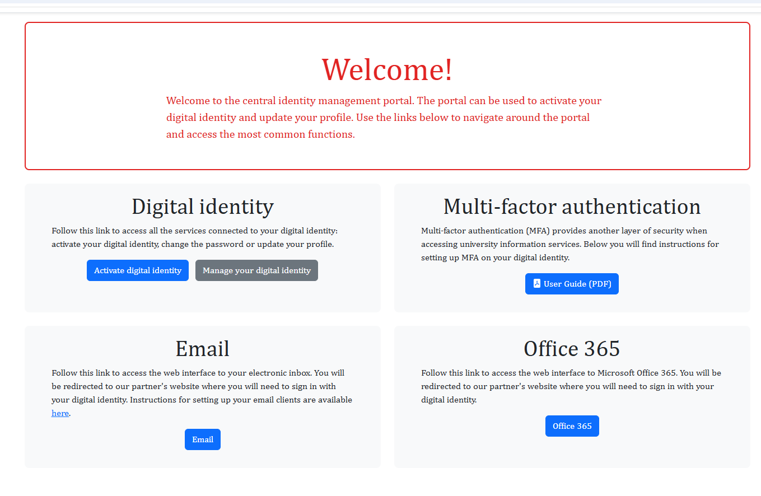
Digital ID / University e-mail
Digital Identity: ID Portal (activate digital identity)
Digital Identity Issues: Help and Support (report a problem)
UL ID and university e-mail: ab12345@student.uni-lj.si
Provides access to:
e-mail services
the university wireless network
FDV and University of Ljubljana information systems
computers at FDV
Multi-factor authentication: another protection when you log in to university online services: you need to change your password every 3 months!

Slide 5
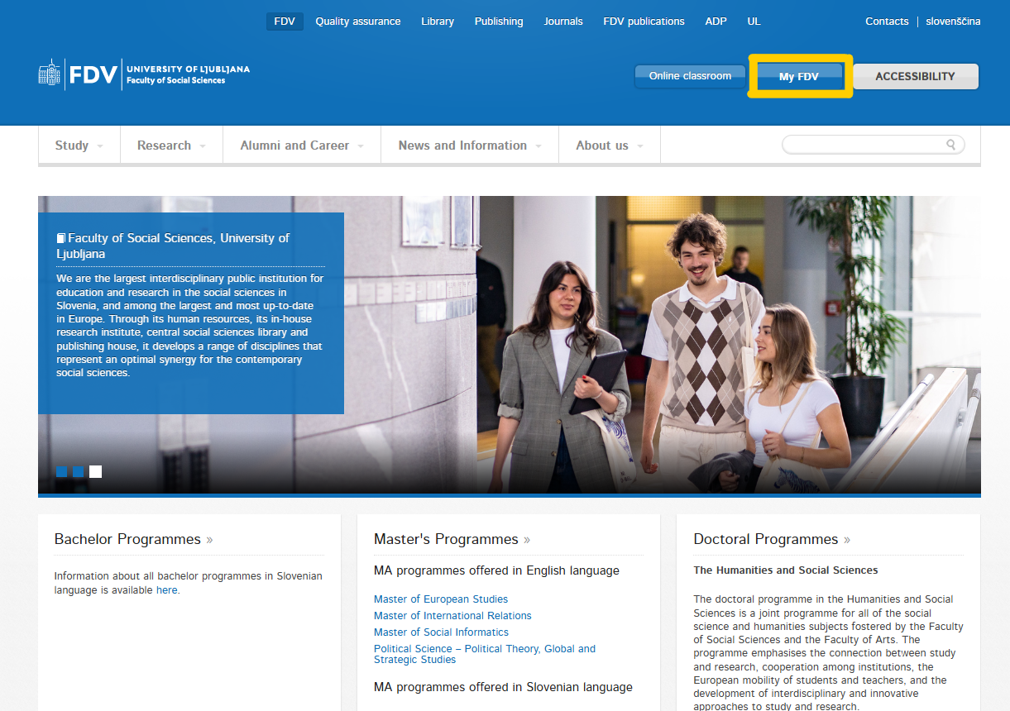
My FDV
open the website
–
Faculty of Social Sciences
–
click
„My FDV“
CLIKC

Slide 6
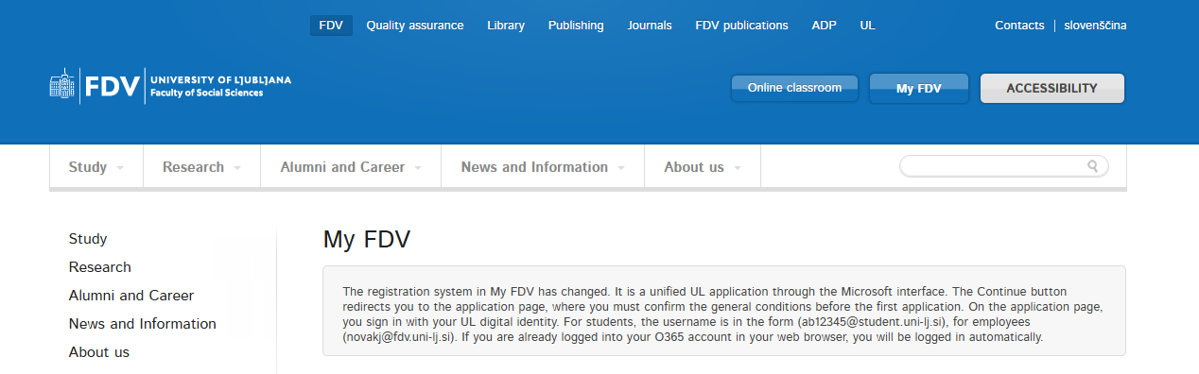
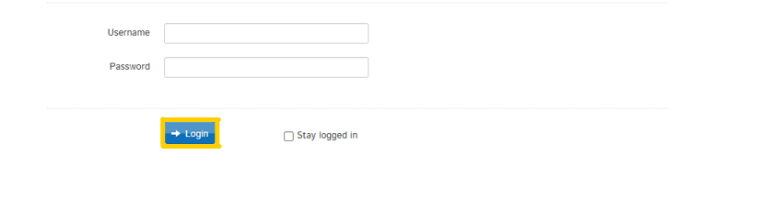
My FDV
enter your username
(e.g. ab12345@student.uni-lj.si)
–
enter your password
(you made it up when creating
your Digital ID)

Slide 7
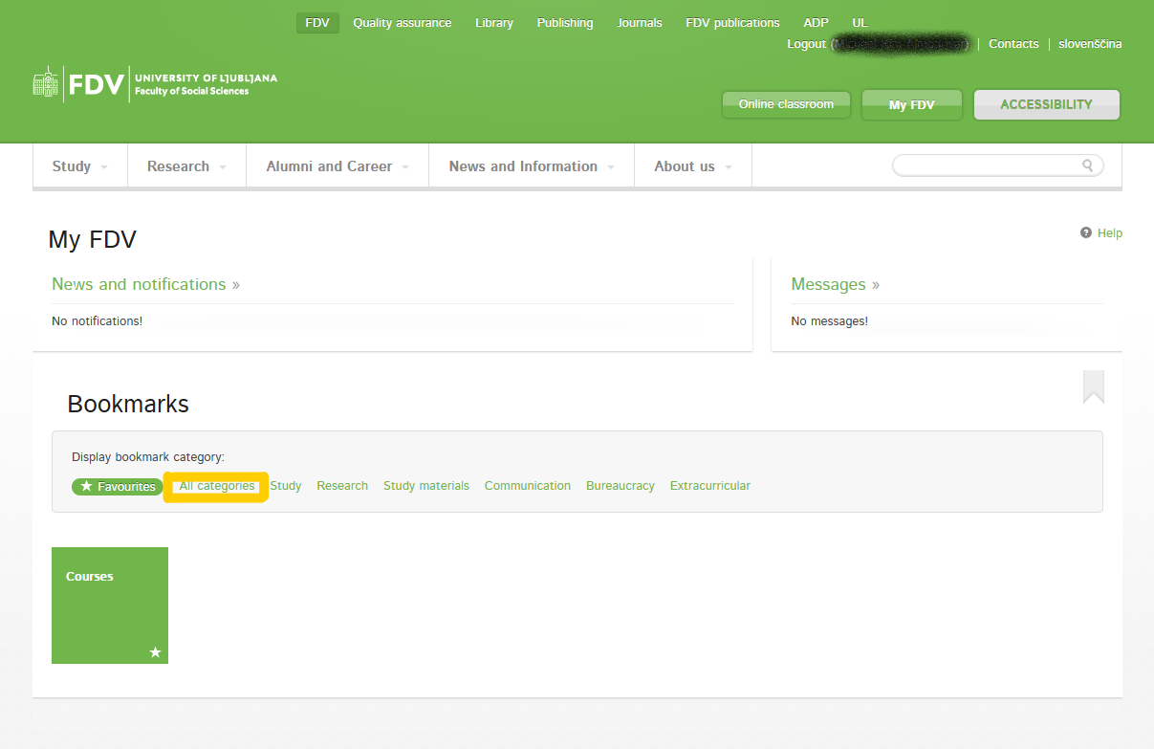
My FDV
click „All categories“

Slide 8
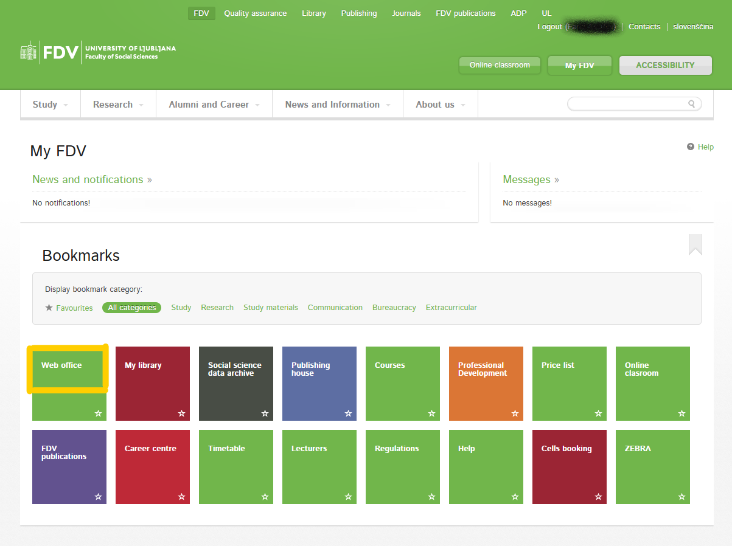
Web Office - My FDV
click „Web office“

Slide 9
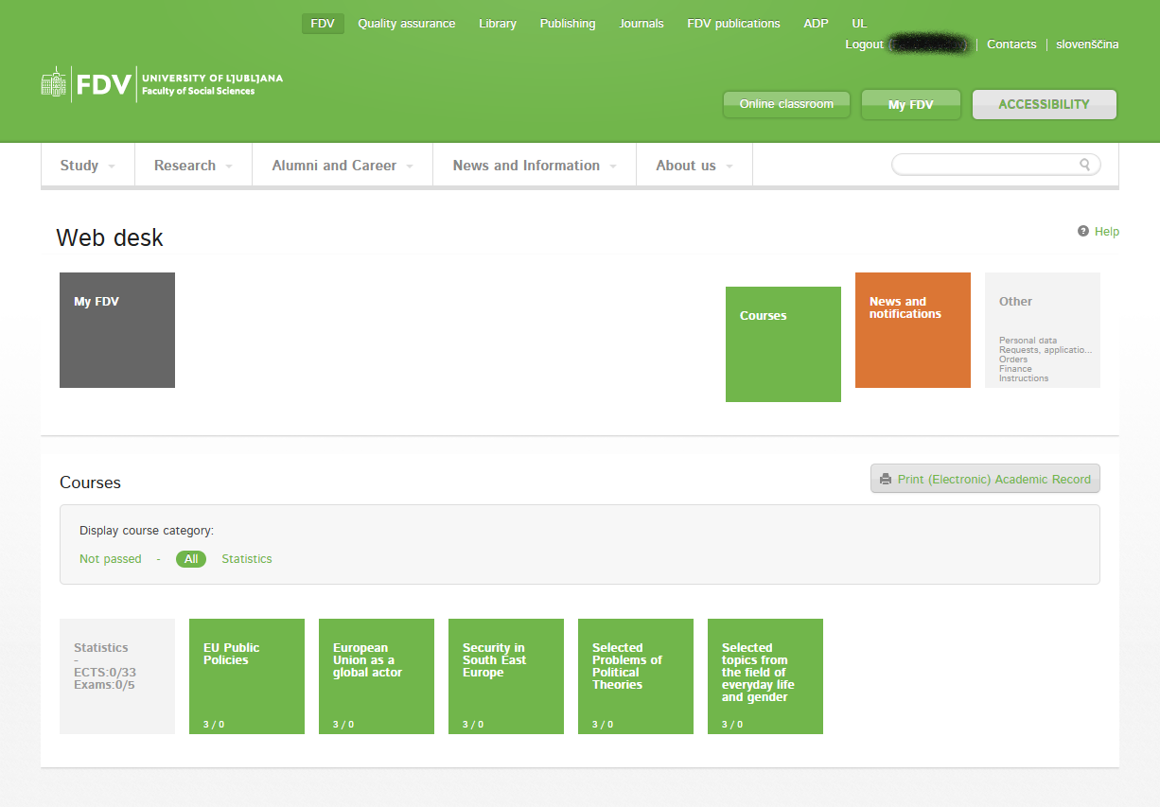
Web Office - My FDV
all registered courses will appear
Register for exam(s) at least 3 days before the exam date in your web office!

Slide 10
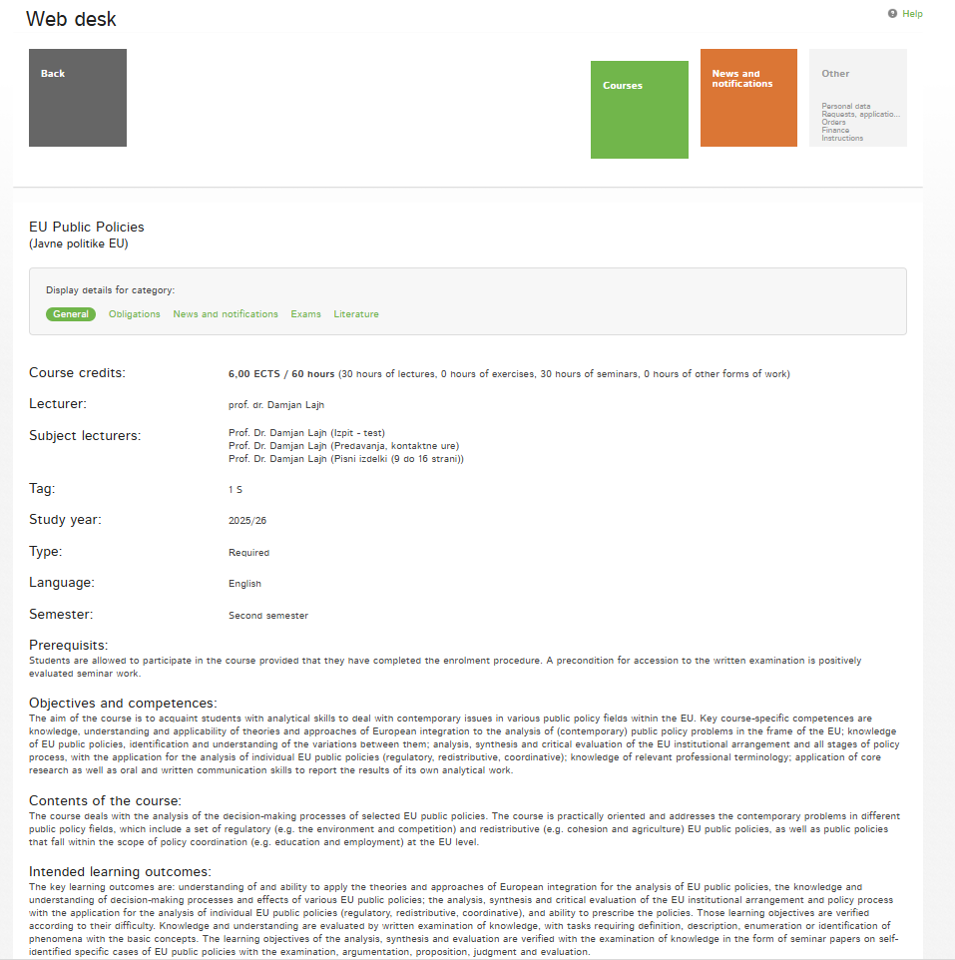
Web Office - My FDV
check information under all categories (general, obligations, exams, ...)

Slide 11
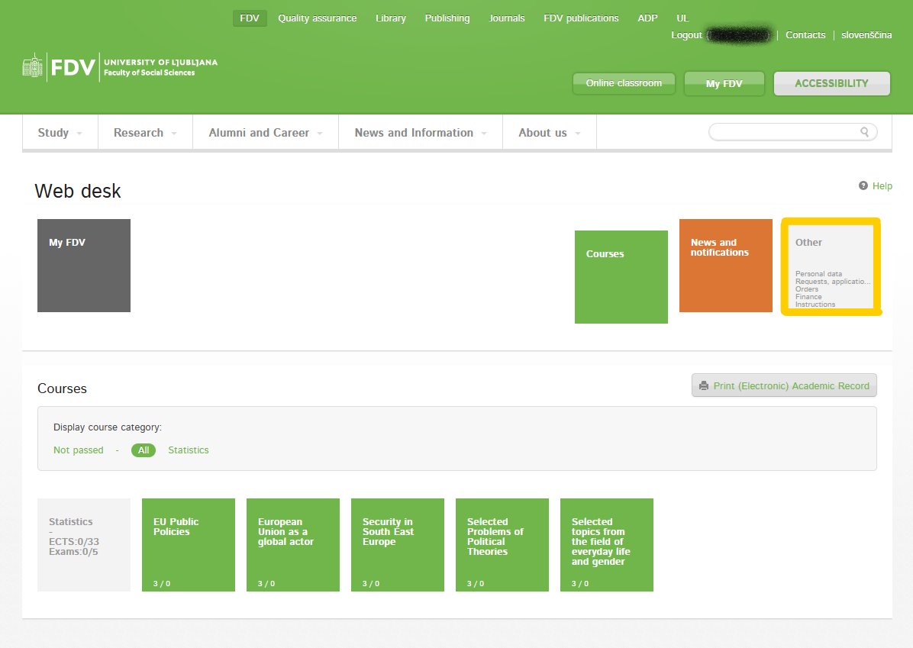
Web Office - My FDV
click „Other“

Slide 12
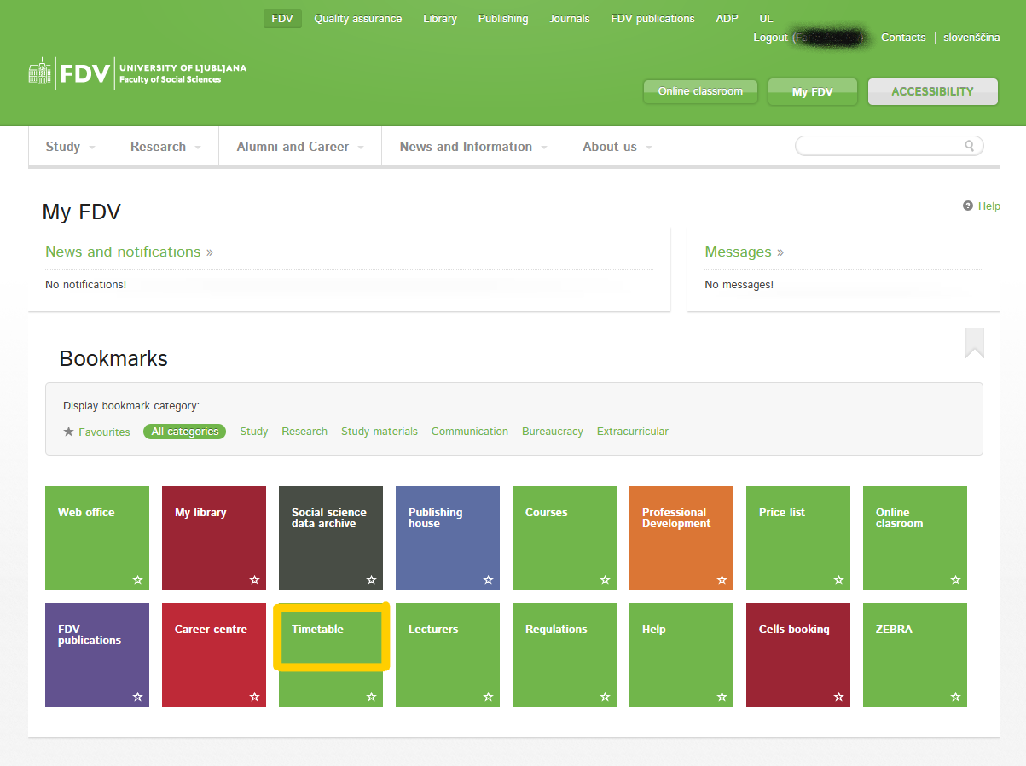
Web Office - My FDV
go back to „All categories“
–
click „Timetable“

Slide 13
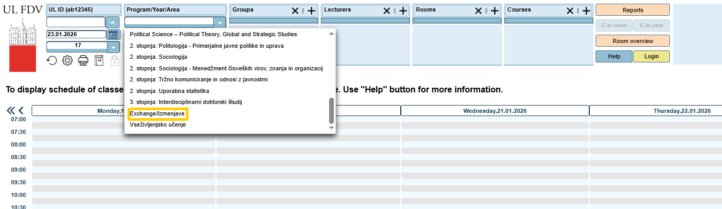
Timetable – Option 1
click the pop-up menu under „Program/Year/Area“ section – scroll down and click
„Exchange/Izmenjave“ = all bachelor and master level courses for mobility
students will appear

Slide 14
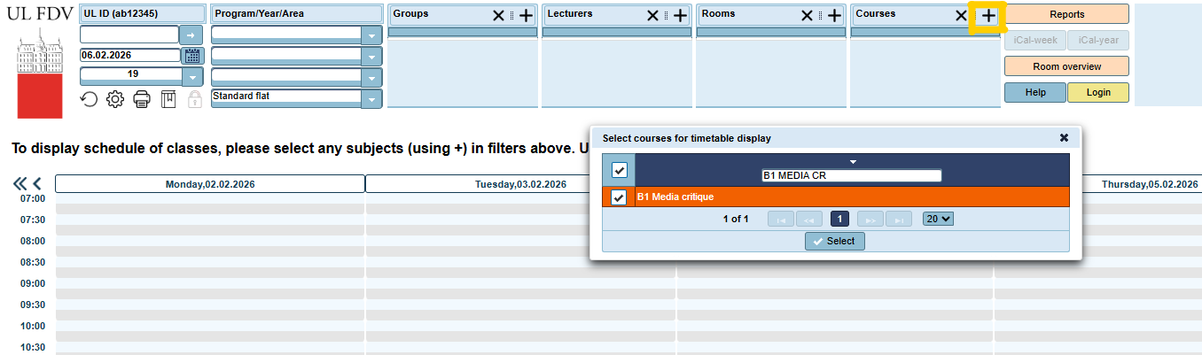
Timetable – Option 2
click the plus (+) in the right-hand side corner – a smaller window will open =
type in B1 (for bachelor level courses) or B2 (for master level course) + course name =
Click „Select“ = timetable for specific course will appear

Slide 15
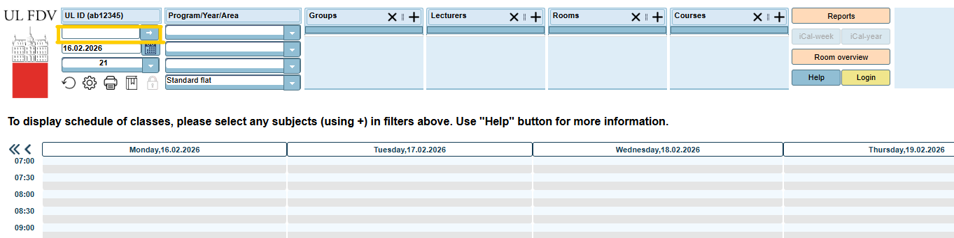
Timetable – Option 3
in the left-hand side corner type in the first part of your Digital ID
(for example, pz56348 only and not pz56348@student.uni-lj.si) =
only courses you have registered for will appear

Slide 16
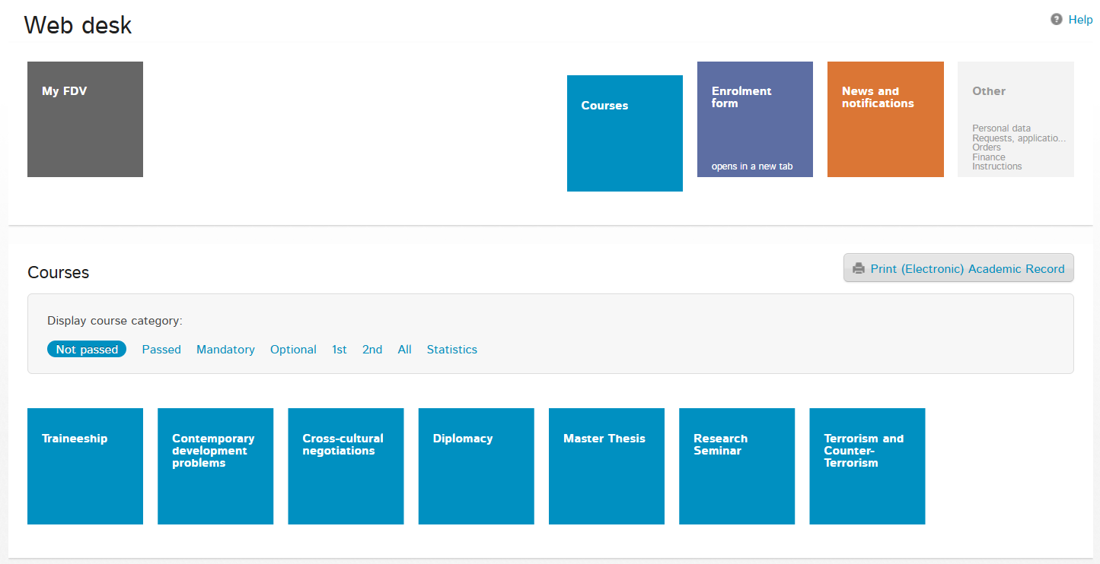
Courses at the Faculty of Social Sciences
Social, Cultural, Political and Communication Sciences
Courses

Slide 17
Course Attendance and Obligations
mostly REQUIRED and most likely as a PREREQUISITE FOR EXAM(S)
the students' obligations can be viewed in the Web Office and will be presented in the first lecture of each course. If anything is unclear, please ask the professor in the first lecture
follow the guidelines for writing and editing papers at FDV as prescribed by APA citation style: https://www.fdv.uni-lj.si/docs/default-source/dodiplomski-studij-1-stopnje/guidelines-for-writing-and-editing-professional-and-scientific-works-at-fdv.pdf

Slide 18
Courses at other faculties
Coordinators emails:
Faculty of Arts | Ms dr. Tjaša Ribizel Popič | mobility@ff.uni-lj.si
Faculty of Social Work | Mr Borut Petrović Jesenovac | office@fsd.uni-lj.si
Faculty of Law | Ms Lea Kremič | lea.kremic@pf.uni-lj.si
Faculty of Education | Mr Robert Gracar | mednarodna@pef.uni-lj.si
Faculties of the University of Ljubljana are very different entities:
  you will not see courses registered at other faculties in the MyFDV web office,
  all academic actions must be done by their international office / web office,
  at the end of your mobility you will receive a separate Transcript of Records.

Slide 19
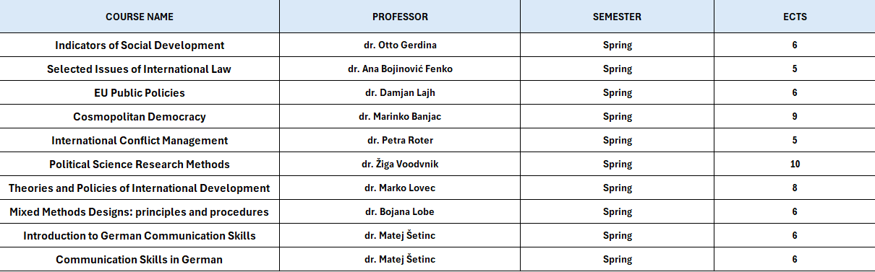
MA courses opened to BA students

Slide 20
English for specific purposes/Introduction to the language for specific purposes – English
Italian for specific purposes I and II/Introduction to the language for specific purposes - Italian
French for specific purposes I and II/Introduction to the language for specific purposes - French
German for specific purposes I and II/Introduction to the language for specific purposes - German
Spanish for specific purposes I and II/ Introduction to the language for specific purposes – Spanish
REGISTRATION:
- write an email to dr. Nina Gorenc, Lector: nina.gorenc@fdv.uni-lj.si
- stating your level of knowledge and field of studies
Language courses

Slide 21
The 3 documents
THERE ARE ONLY THREE DOCUMENTS THAT NEED TO BE PROCESSED BEFORE / DURING / AT THE END OF YOUR MOBILITY
Online Learning Agreement (OLA) / Learning Agreement (LA)
Confirmation of Stay
Transcript of Records

Slide 22
1) Online Learning Agreement (OLA)
if you do not know how to make changes to your OLA, check with your home coordinator
when preparing OLA in your university‘s platform it is of utmost importance to use office.international@fdv.uni-lj.si email address – it is only this way that your OLA can be linked to our system for a review and signature
2) Learing Agreement (LA)
if you do not know how make changes to your LA, check with your home coordinator
send (unlocked!) pdf version to office.international@fdv.uni-lj.si – we will review and sign LA; a signed copy will be emailed back to you

Slide 23
Confirmation of Stay – 1
differently named documents: e.g. Confirmation of Stay / Confirmation of Studies / Letter of Confirmation / Certificate of Attendance / Confirmation of Attendance, Coonfirmation of Arrival/departure or similar
in case the document was not provided ask your home coordinator to provide you with the document
only in case your home coordinator does not provide with the document, we will hand out our version of the document
FILL OUT THE DOCUMENT IN FULL and send it to office.international@fdv.uni-lj.si

Slide 24
Confirmation of Stay – 2
Start date: Welcome and Orientation Day – 12th February 2026
(in case you took part in the Slovenian language course – 26th January 2026)
End date: 15th June 2026
in case you finish academic obligations earlier and plan to leave Ljubljana before the 15th June 2026, stop by our office one day prior or on the day of you departure
in case you finish your academic obligations later than 15th June 2026, stop by our office one day prior or on the day of your departure

Slide 25
Transcript of Records
go to My FDV
–
click „Web office“

Slide 26
Transcript of Records
click „Other“

Slide 27
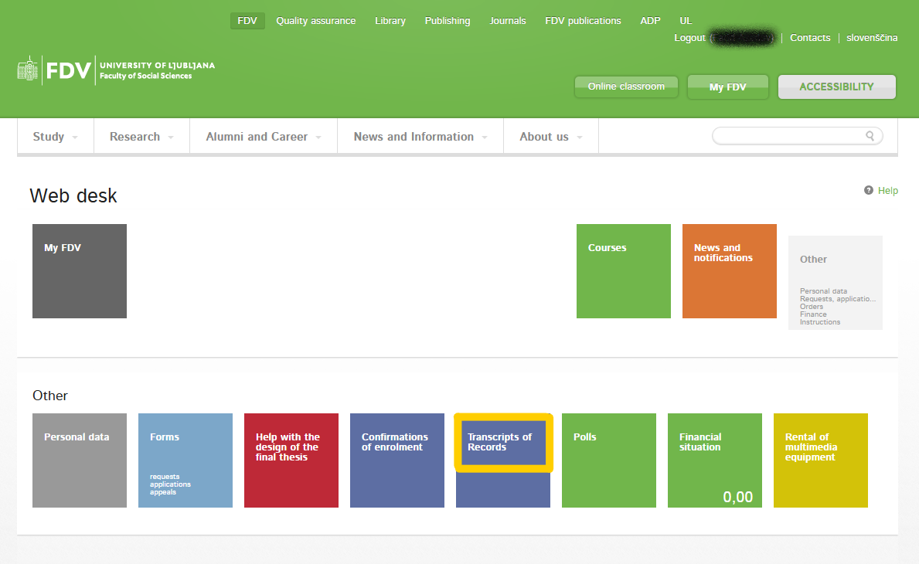
Transcript of Records
once you complete all exams you can retrieve Transcript of Records directly from web office –
click „Transcript of Records“

Slide 28
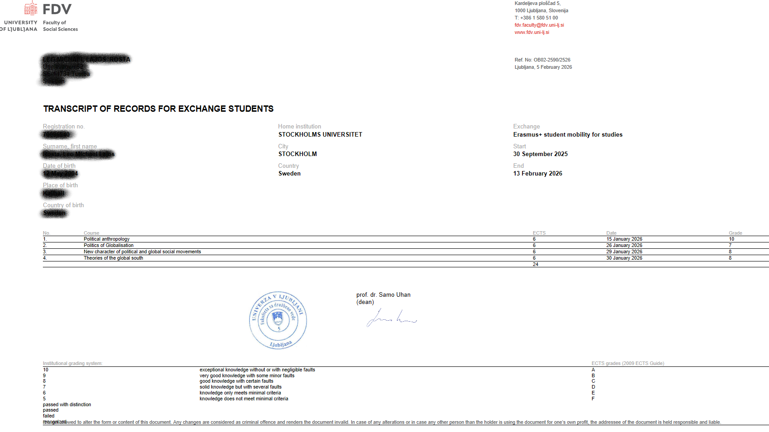
Transcript of Records
in case your home institution requires ToR to be sent directly from our to their office
–
provide us with the email address to which ToR should be sent to

Slide 29
Information you need to memorize
Responsible person at the receiving institution:
Name: Zoran Pečar
Position: Student Mobility Coordinator
Email: office.international@fdv.uni-lj.si
Phone: 00386 (0)1 5805 279
Office hours: Monday – Friday: 11.00 – 13.00
Office location: DS-01 (on the subterrene level)

Slide 30
DROP OFF PERIOD: How to make changes to your LA?
The courses you currently have in your MyFDV web office are confirmed and places are guaranteed
You can change the confirmed courses from 16 February from 20:00 CET until 22 February until 23:59 CET - via your MyFDV web office
No further course changes can be made after the deadline!

Slide 31
DROP OFF: How to make changes to your LA?
ADD A COURSE
DELETE A COURSE
CHANGE A COURSE

Slide 32
DROP OFF PERIOD: How to make changes to your LA?
open the website
–
Faculty of Social Sciences
–
click
„My FDV“

Slide 33
DROP OFF PERIOD: How to make changes to your LA?
click „All categories“

Slide 34
DROP OFF PERIOD: How to make changes to your LA?
click „Web office“

Slide 35
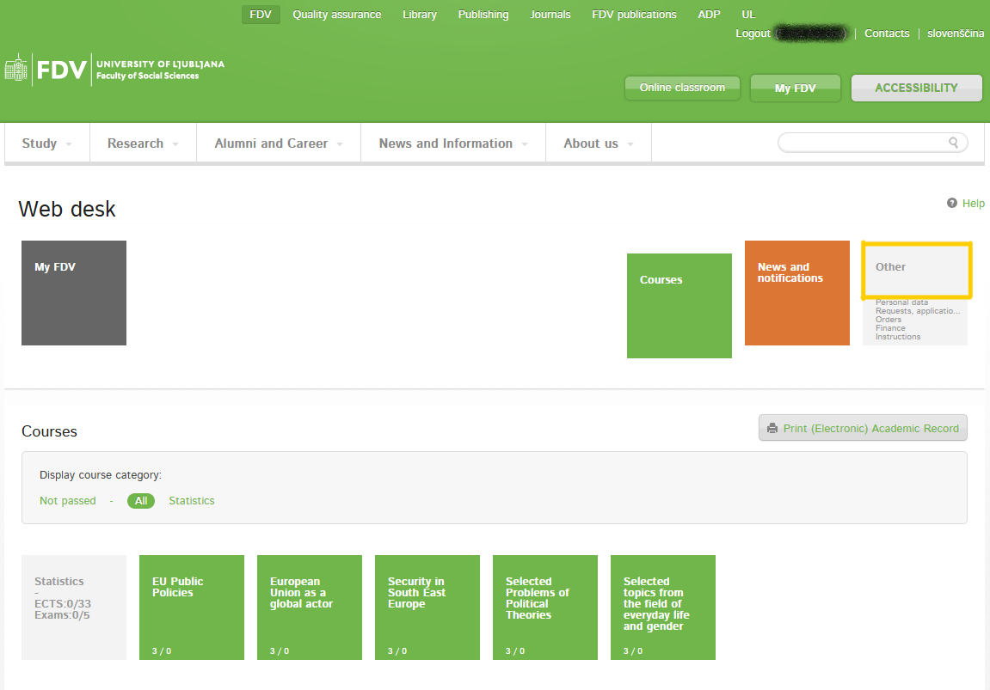
DROP OFF PERIOD: How to make changes to your LA?
click „Other“

Slide 36
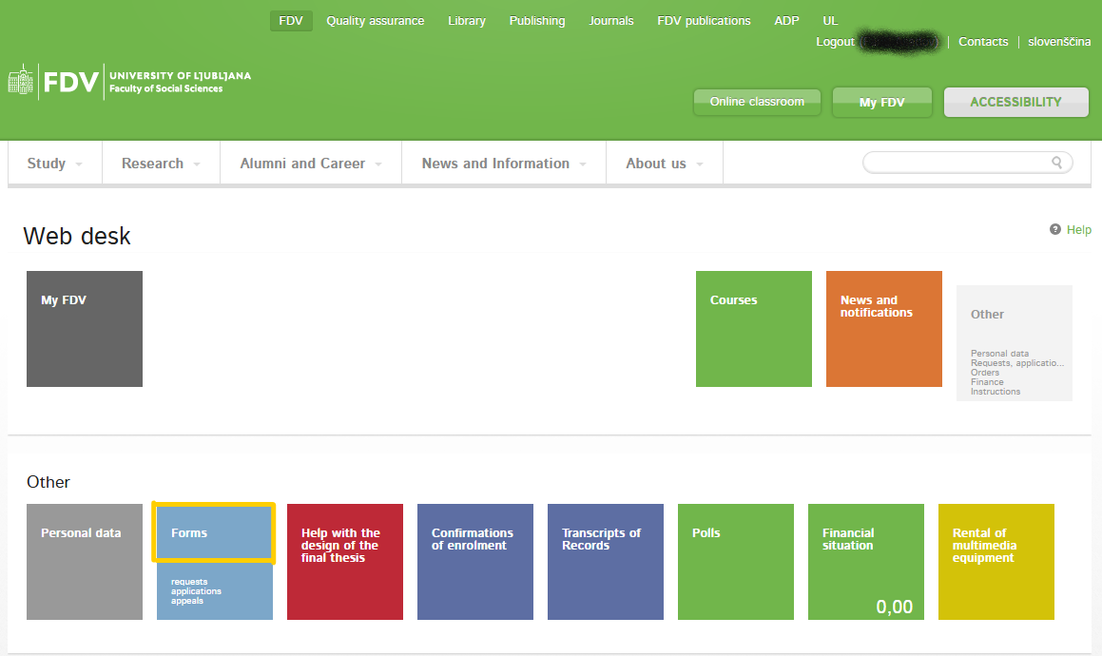
DROP OFF PERIOD: How to make changes to your LA?
click „Forms“

Slide 37
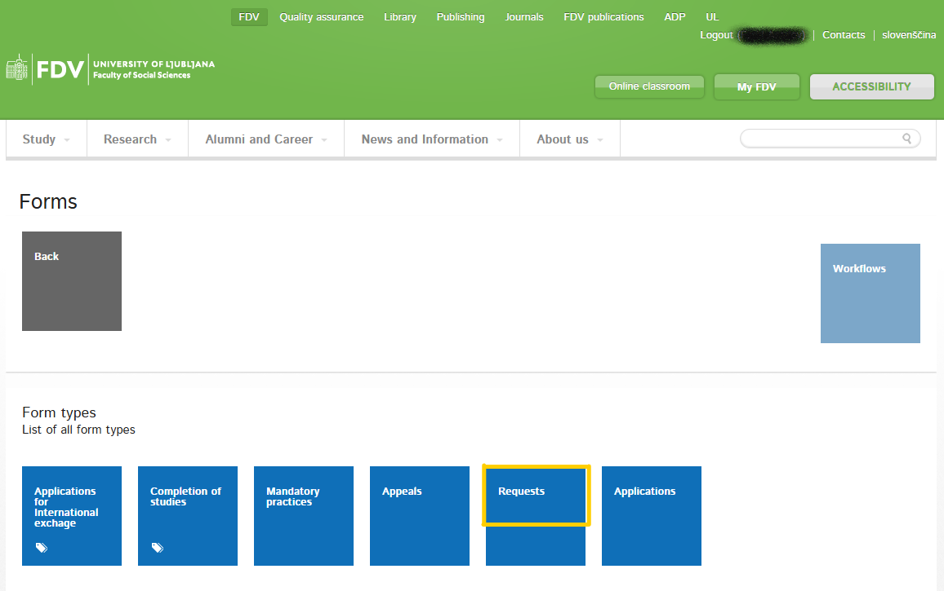
DROP OFF PERIOD: How to make changes to your LA?
click „Requests“

Slide 38
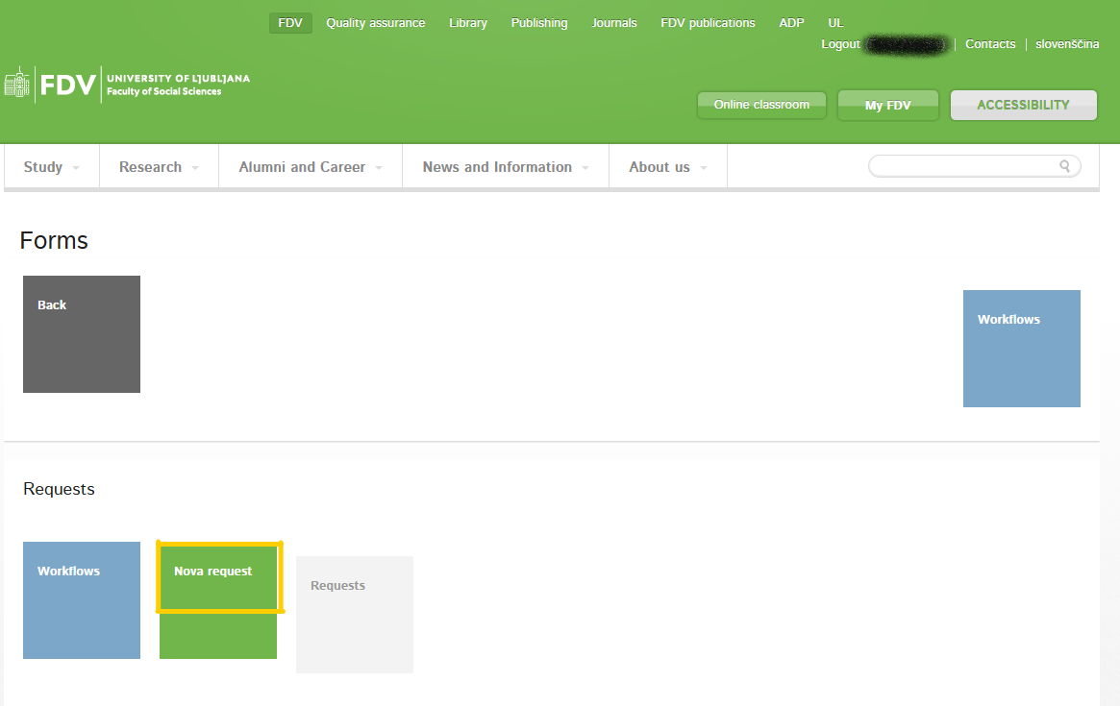
DROP OFF PERIOD: How to make changes to your LA?
click „Nova request“

Slide 39
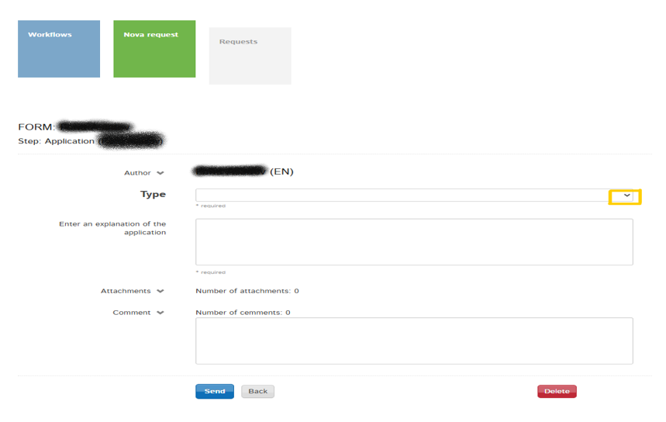
DROP OFF: Replacement of a course
click the arrow to
open the menu

Slide 40
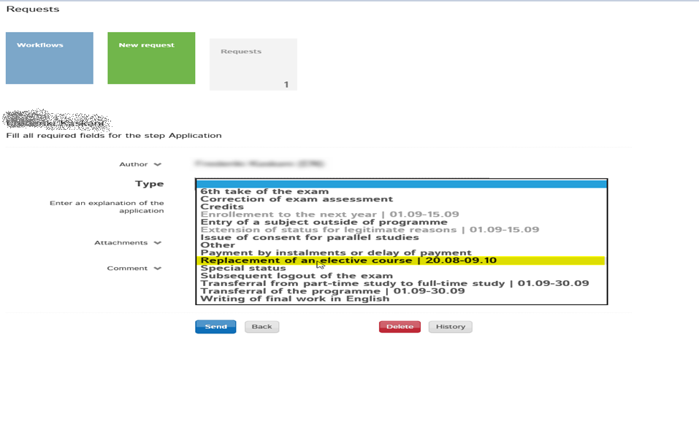
DROP OFF: Replacement of a course
click
„Replacement of an
elective course“

Slide 41
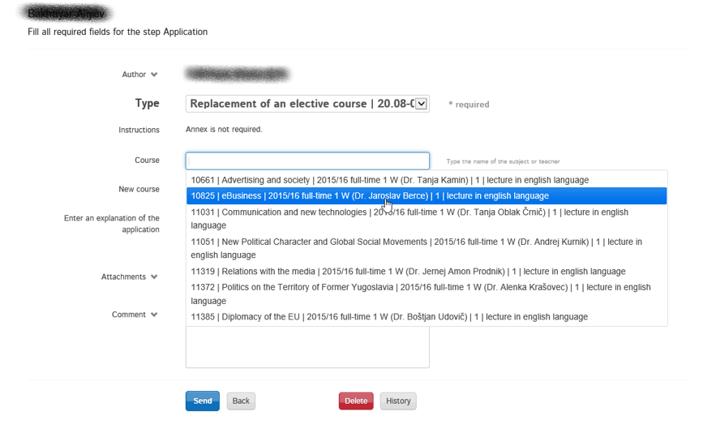
DROP OFF: Replacement of a course
in the „Course“ pop-up menu
–
click the course you
would like to replace

Slide 42
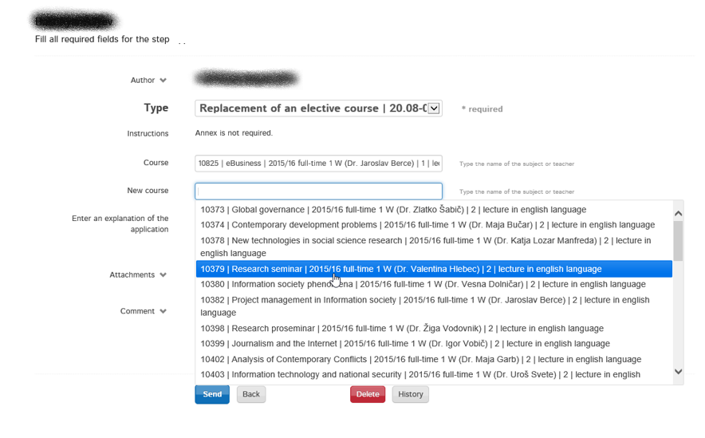
DROP OFF: Replacement of a course
in the „New course“ pop-up menu
–
select a new course
–
click „Send“

Slide 43
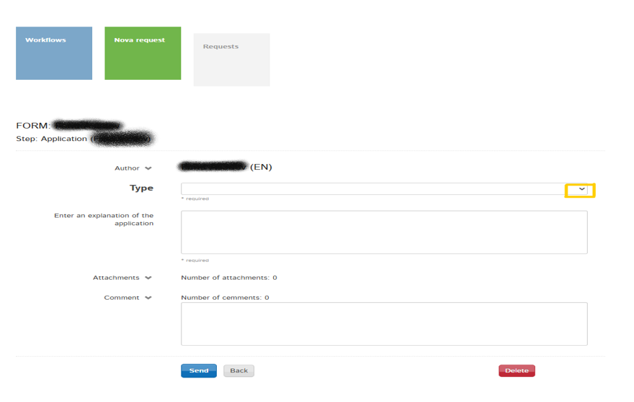
DROP OFF: Removing/deleting a course
click the arrow to
open the menu

Slide 44
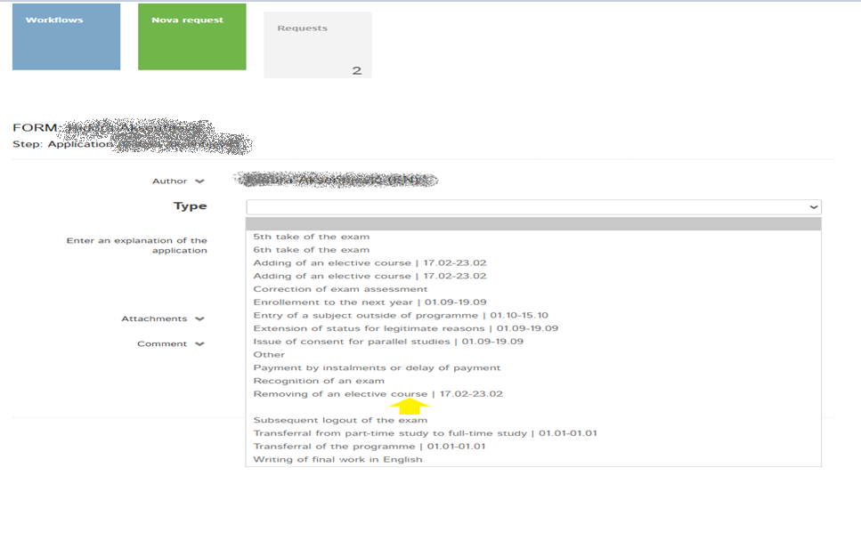
DROP OFF: Removing/deleting a course
click
–
„Removing of an
elective course“

Slide 45
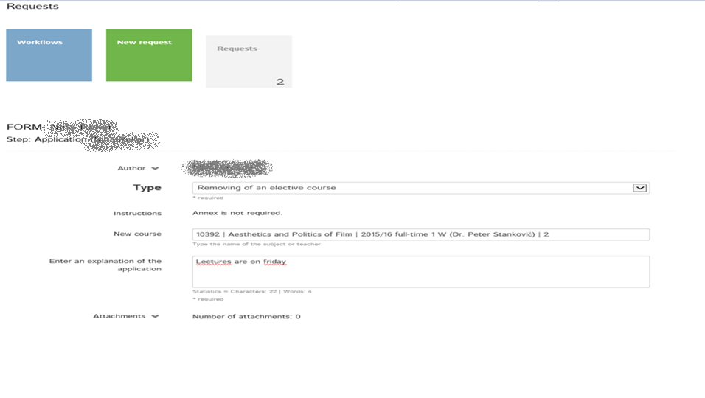
DROP OFF: Removing/deleting a course
in the „New course“ pop-up menu
–
click the course you would like to delete
–
click „Send“

Slide 46
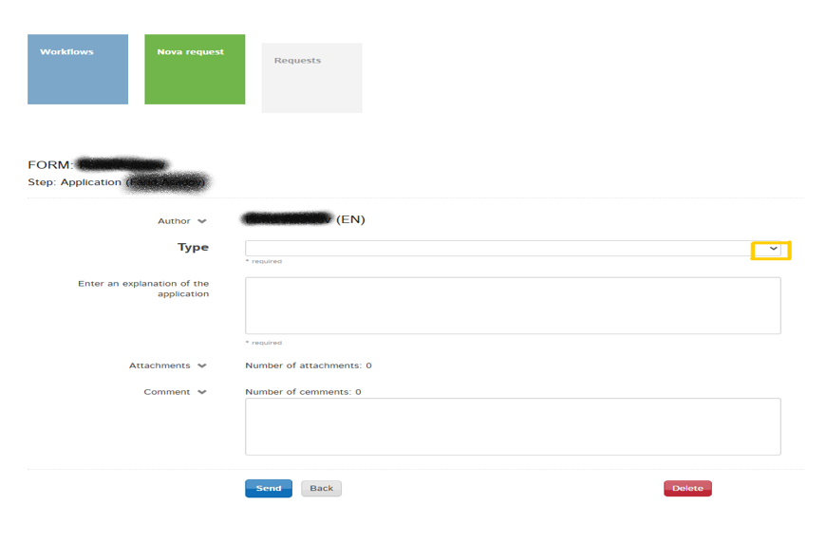
DROP OFF: Adding a course
click the arrow to
open the menu

Slide 47
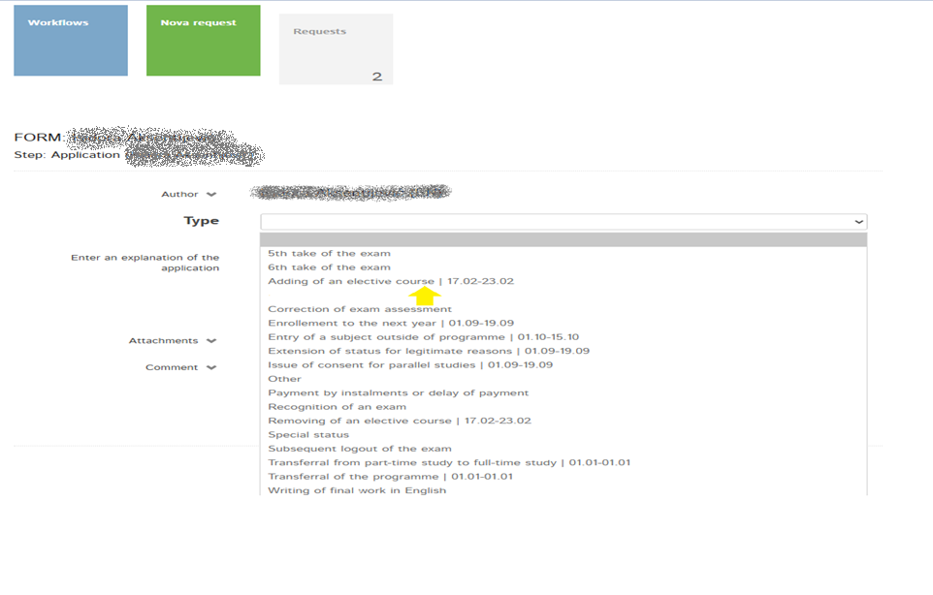
DROP OFF: Adding a course
click
–
„Adding of an
elective course“

Slide 48
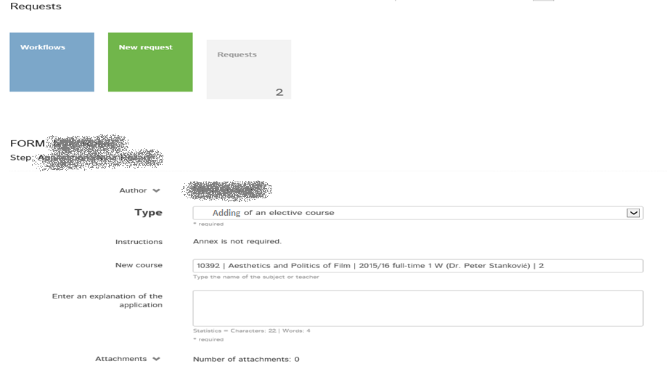
DROP OFF: Adding a course
in the „New course“ pop-up menu
–
click the course you would like to add
–
click „Send“

Slide 49
Drop Off Period
after you have submitted your request, all requests will be processed by the International Exchange Office
as this process takes some time, you will not receive an immediate response, but as soon as all requests have been processed (appropriately by 25th February 2026 at the latest)
we will NOT send out new (O)LAs automatically, you will have to prepare them yourself after the Drop Off Period!

Slide 50
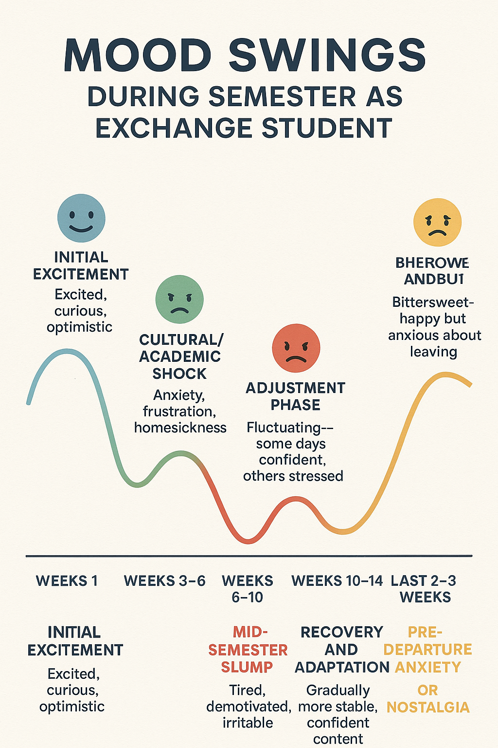
Being a Foreign Student in Slovenia: Mood swings during the exchange

Slide 51
Being a Foreign in Slovenia: I‘m struggling. Who can I talk to?
Your Schoolmates
They most likely face the same issues as you.
Student Tutors and Buddies
They are here to help you out or at least direct you to appropriate help.
Student Psychosocial Counseling
https://www.uni-lj.si/en/university/equality-and-inclusion/psychosocial-counselling-service
Student Law Counseling
http://www.svetovalnica.com/

Slide 52
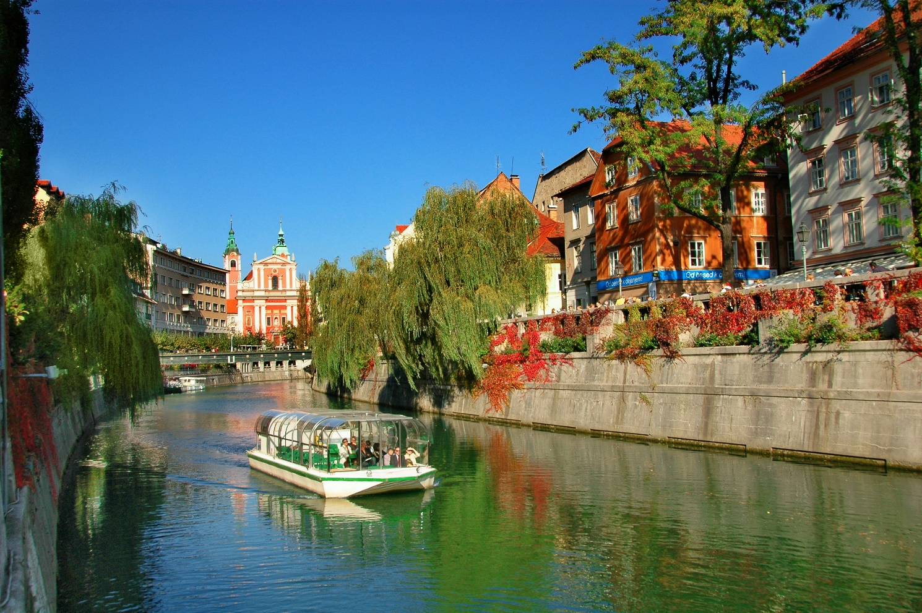
Being a Foreign Student in Slovenia
https://www.youtube.com/watch?v=WL83EFMZ51U

Slide 53
Presentation of Student Tutors
Tutor System

Slide 54
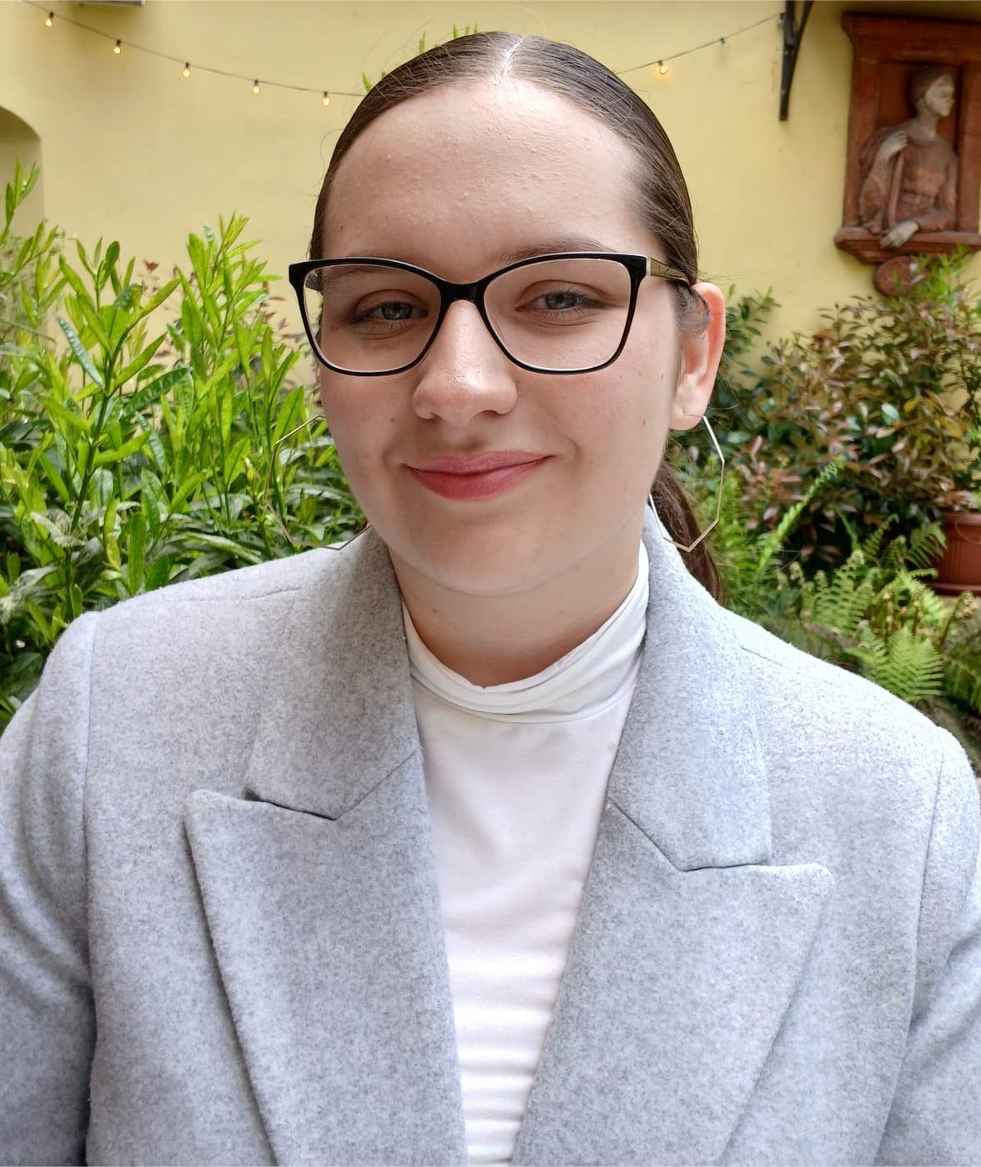
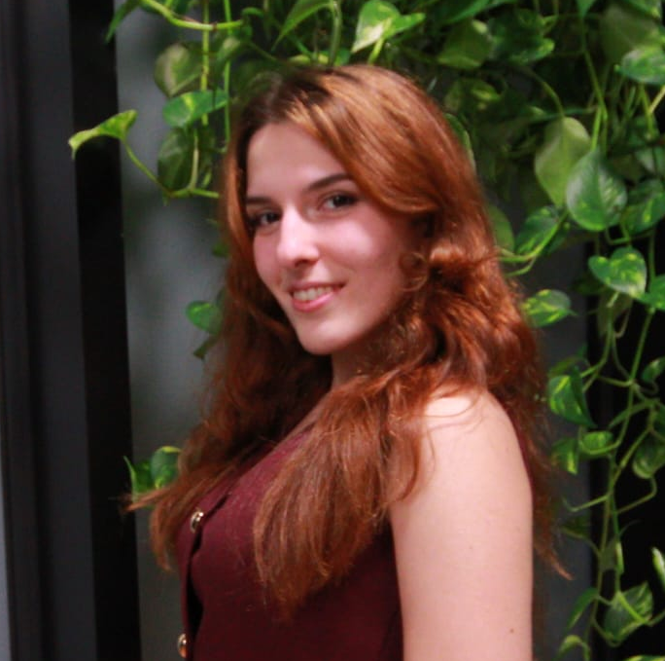
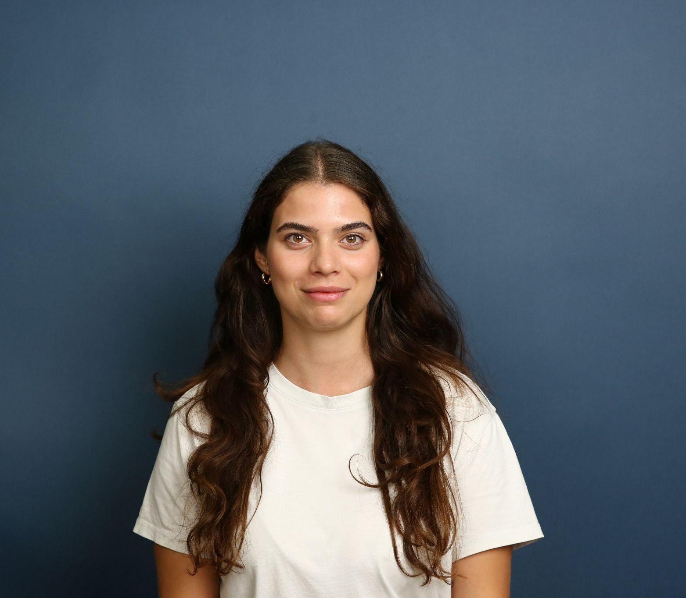

Student tutors
Mia Ilić
miailic2004@gmail.com
Instagram: @ilicmia_
+386 69 701 656
Anja Miletić
anjamilet@gmail.com
Instagram: @anjamileticc
+386 69 728 774
Sabina Salihović
sabinasalihovic2206@gmail.com
Instagram: @sabinbin_
+386 40682501
Matija Pantić
Instagram:@pmatijaa
+386 69 702 257

Slide 55
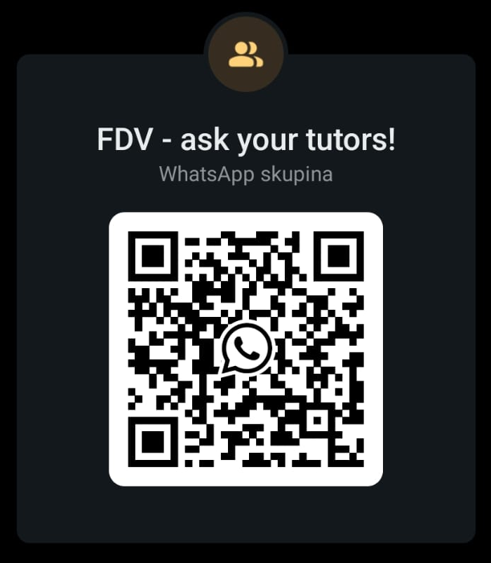
WhatsApp group with your tutors:
https://chat.whatsapp.com/EXgA9lhygEV8spEu5zGNBJ

Slide 56
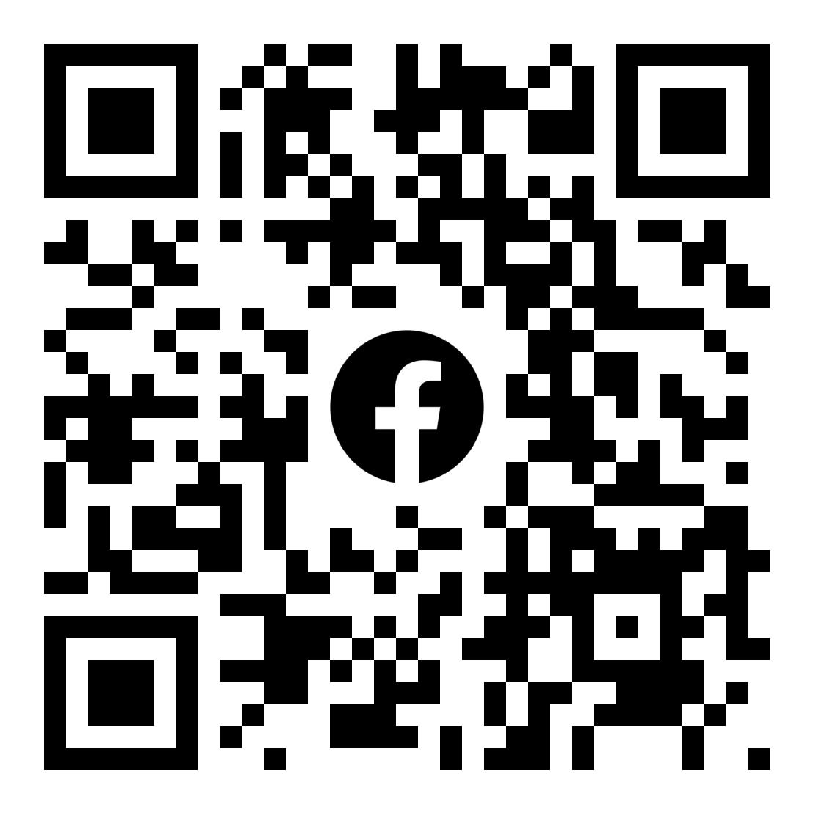





Thank you for your attention!

Slide 57
We wish you a remarkable semester full of stories, knowledge and new friendships!

