Slide 1
Welcome and Orientation Day
30 September 2026

Slide 2
Outline of the day
Time | Session | Speakers
11.00 – 11.10 | Opening and outline of the day | Maša Kolenbrand, Head of International Relations Office
11.10 – 11.15 | Welcome address | Assoc. Prof. Ilija Tomanić Trivundža, Vice-Dean for Student Affairs
11.15 – 11.30 | Basic information: academic calendar, course obligations and attendance exams, student psychosocial and law counselling and other useful information | Zoran Pečar, Student Mobility Coordinator
11.30 – 11.45 | Faculty library presentation | Tina Kalan, Central Social Sciences Library
11.45 – 12.10 | Erasmus Student Network - ESN presentation | ESN representative
12.10 – 12.20 | Meet the student tutors | Tutors for international students

Slide 3
Outline of the day
International Degree Bachelor and Master Students
Room: FDV-02
Time | Session | Speakers
12.30 – 13.30 | Specific information for degree-seeking students (web office, etc.), Q&A | Maša Rošić, Student Mobility Coordinator
International Exchange Students
Room: FDV-01
Time | Session | Speakers
12.30 – 13.30 | Specific information for degree-seeking students (web office, drop-off period, learning agreements, etc.), Q&A | Zoran Pečar, Student Mobility Coordinator

Slide 4
Academic Calendar 2026/27
Autumn Semester
October 1, 2026 – January 15, 2027 (October 1, 2026 = no lectures)
December 28, 2026 – December 31, 2026 = no lectures
January 18, 2027 – February 12, 2027 = Winter Examination Period
Spring Semester
February 15, 2027 – May 28, 2027
April 30, 2027 – April 30, 2027 = no lectures
May 31, 2027 – June 30, 2027 = Summer Examination Period
August 16, 2027 – September 10, 2027 = Fall Examination Period

Slide 5
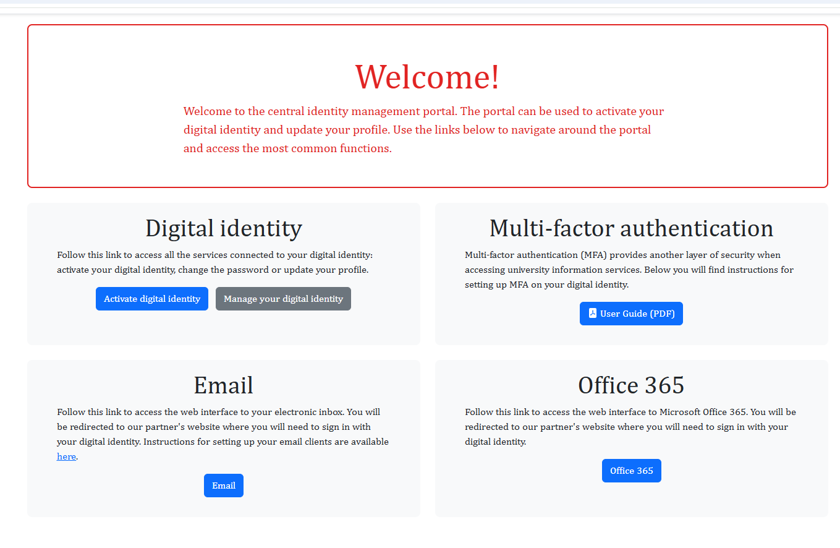
Digital identity – University email
Digital Identity: ID portal (activate digital identity)
UL ID and university e-mail*: ab12345@student.uni-lj.si
Provides access to:
e-mail services
the university wireless network
FDV and University of Ljubljana information systems
computers at FDV
Report problems: Help and support - ID portal
*mandatory use when communicating with professors and
other UL services
Multi-factor authentication: additional protection when you log in to university online services:
you need to change your password every 3 months!

Slide 6
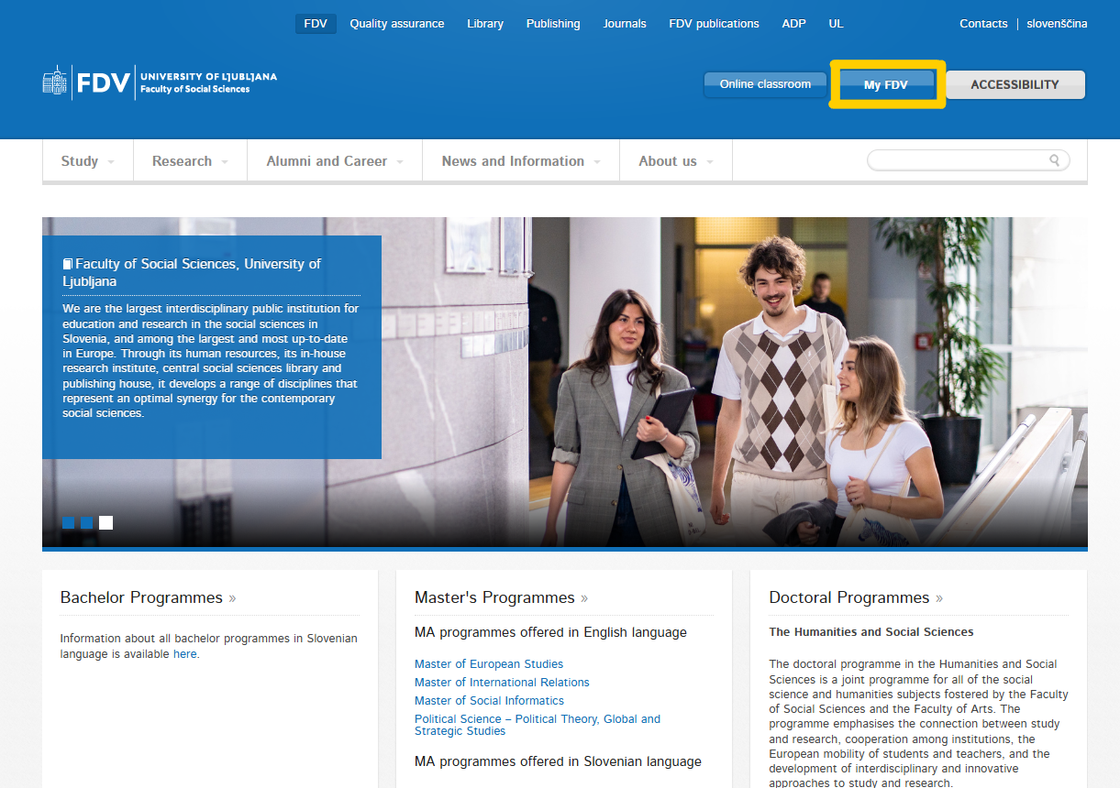
My FDV
open the website
–
Faculty of Social Sciences
–
click
„My FDV“
CLIKC

Slide 7
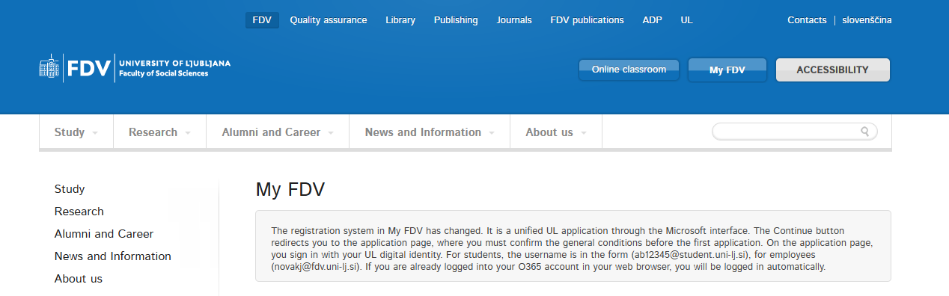
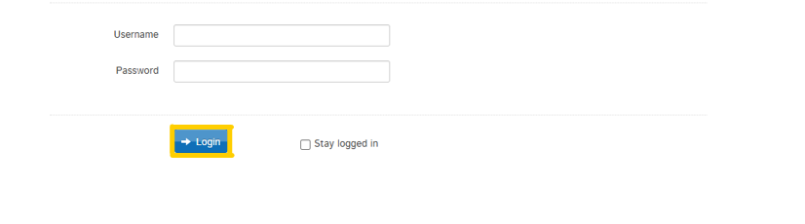
My FDV
enter your username
(e.g. ab12345@student.uni-lj.si)
–
enter your password
(you made it up when creating
your Digital ID)

Slide 8
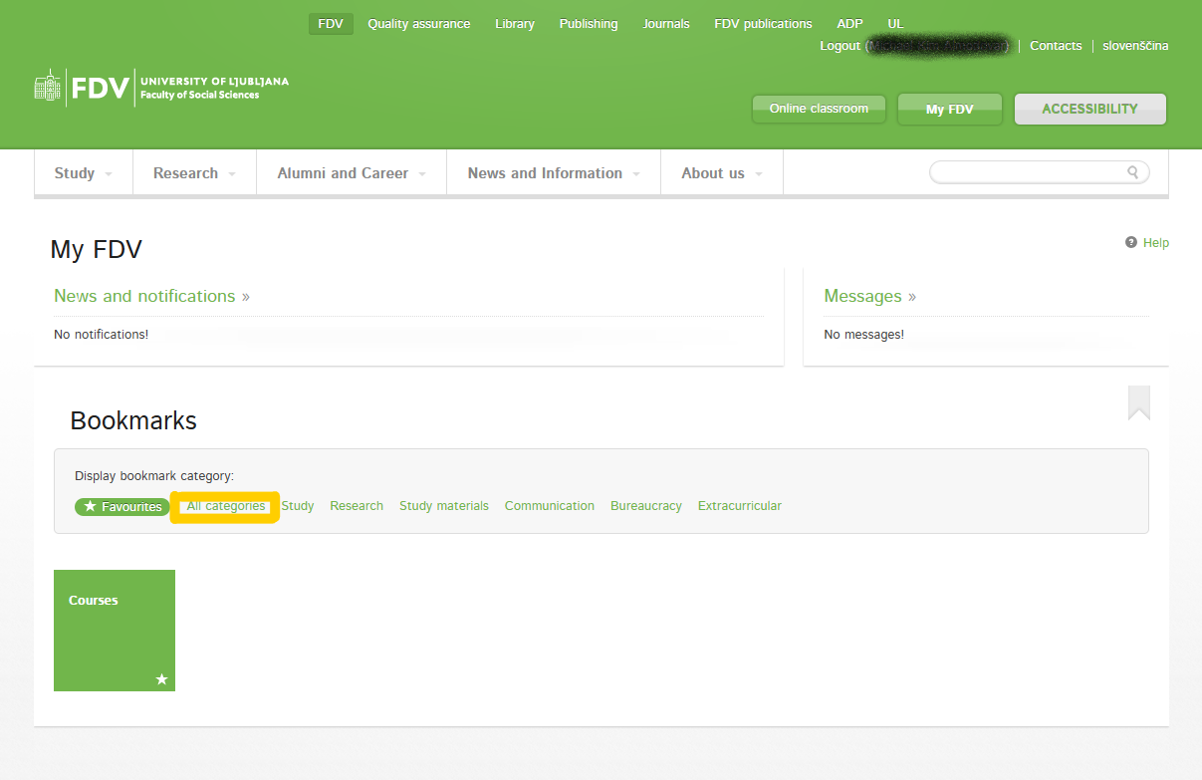
My FDV
click „All categories“

Slide 9
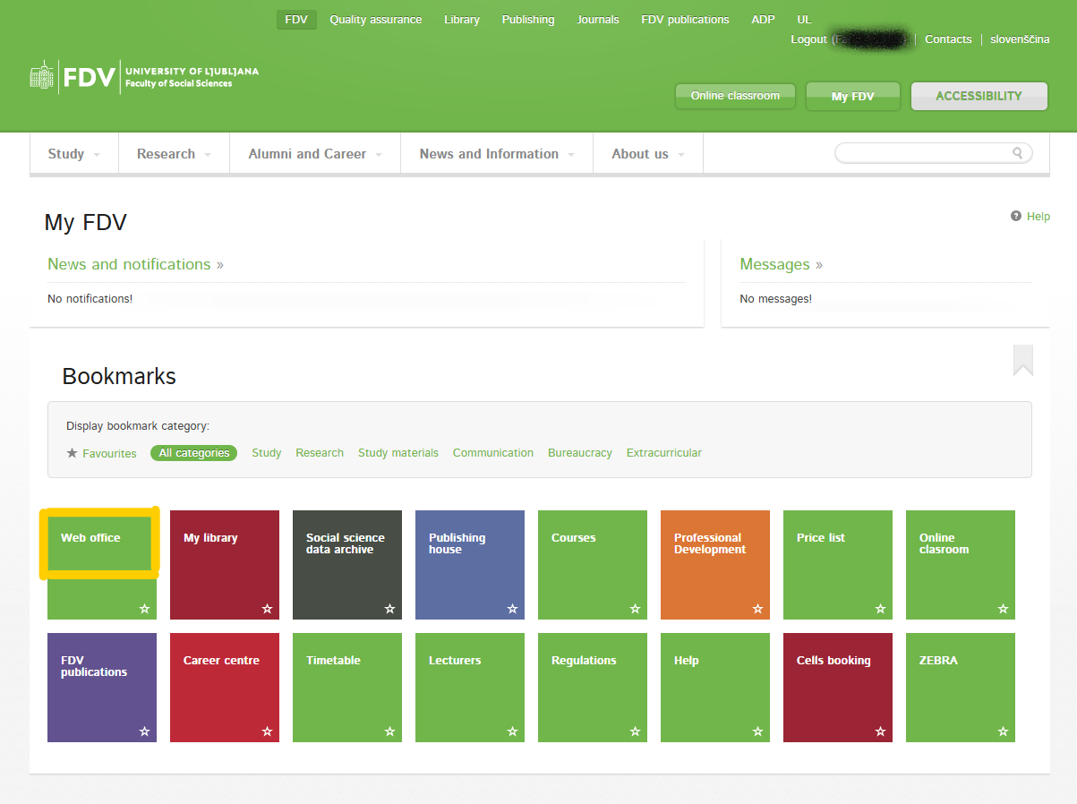
My FDV
click „Web office“

Slide 10
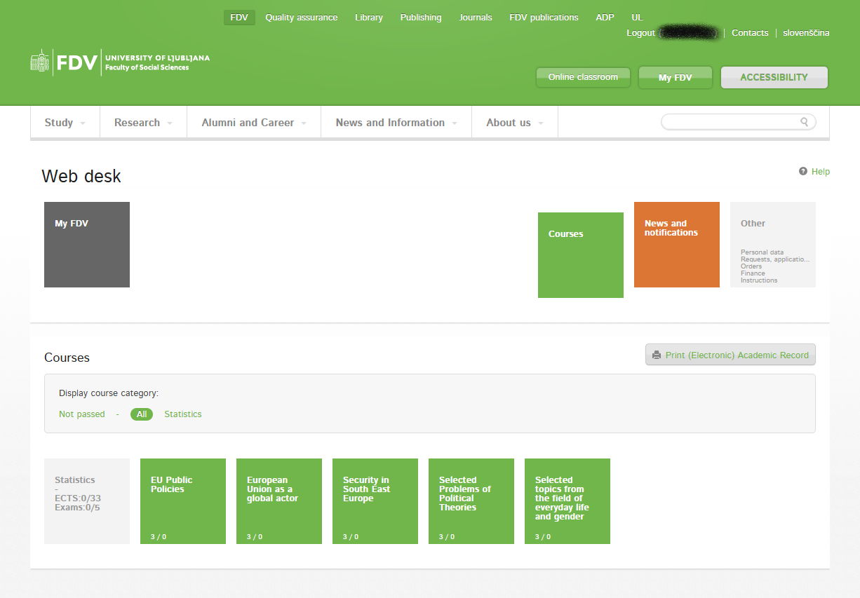
Web Office
all registered courses will appear
–
click the course

Slide 11
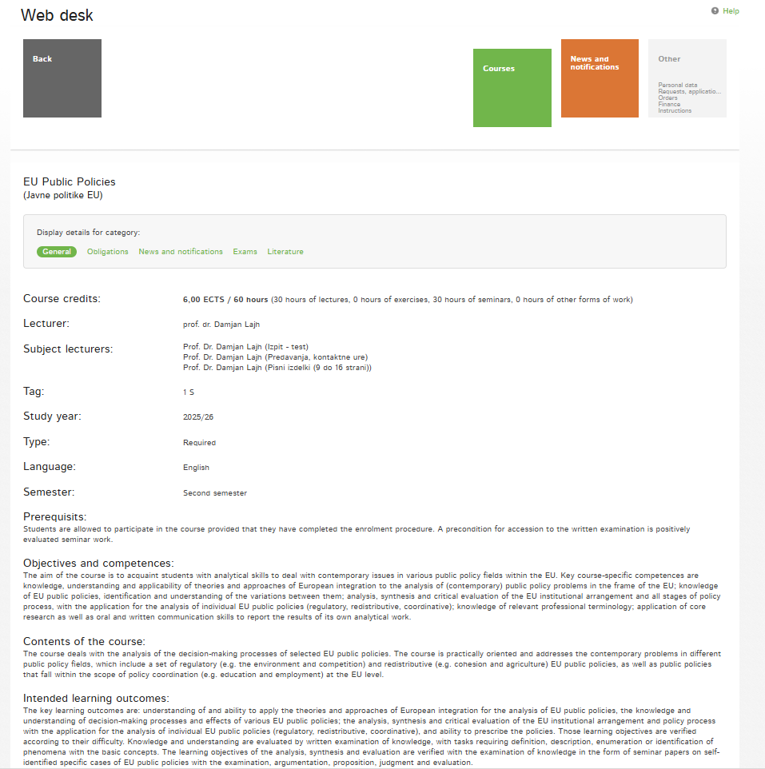
Web Office
check information under all categories (general, obligations, exams, ...)
Register for exam(s) at least 3 days before the exam date!
Deregister from exam(s) at least 1 day (by 12pm) before the exam!

Slide 12
Course Attendance and Obligations
mostly REQUIRED and most likely as a PREREQUISITE FOR EXAM(S)
course obligations are available in the Web Office
if anything is unclear or if you have questions, please ask the professor during the first lecture
follow the guidelines for writing and editing papers at FDV as prescribed by APA citation style: https://www.fdv.uni-lj.si/docs/default-source/dodiplomski-studij-1-stopnje/guidelines-for-writing-and-editing-professional-and-scientific-works-at-fdv.pdf

Slide 13
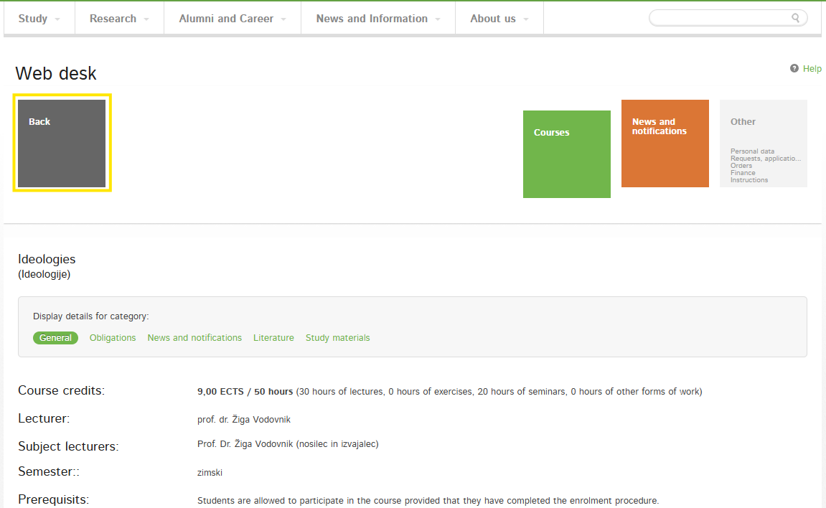
Web Office
click “Back”
–
to get back to “Courses” section

Slide 14
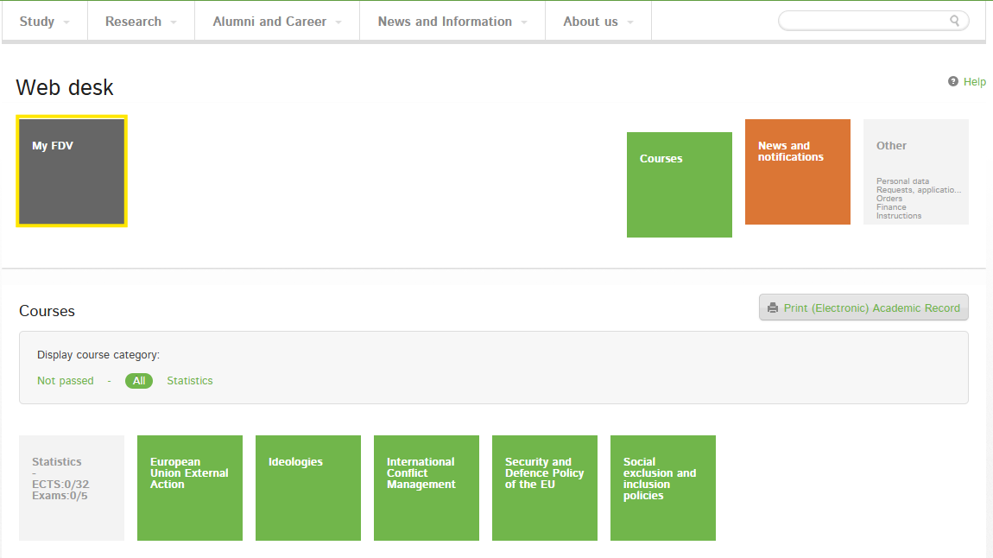
Web Office
click “My FDV”
–
to get back to “All categories” section

Slide 15
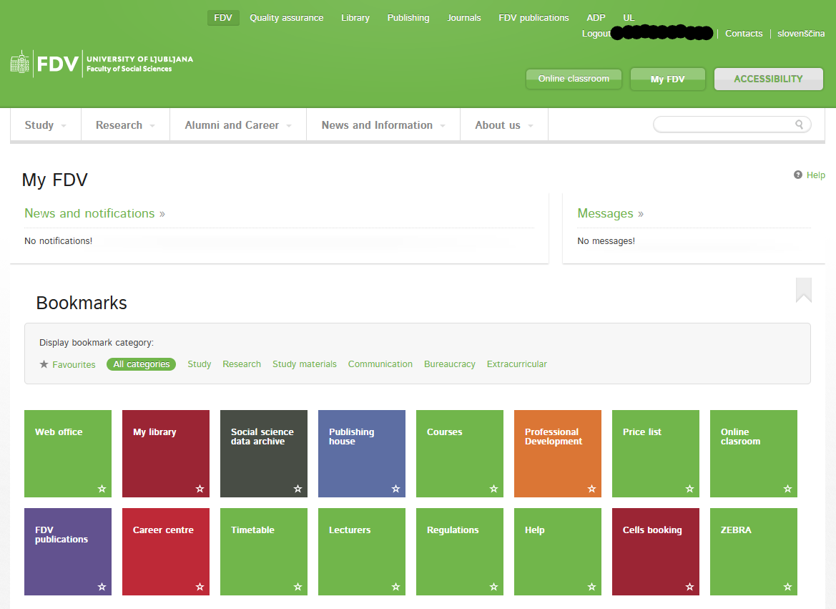
My FDV

Slide 16
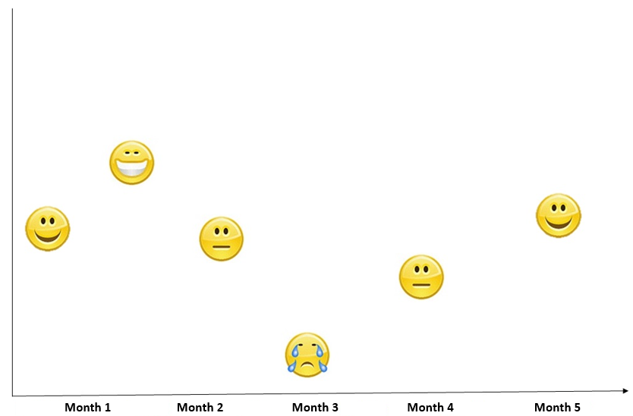
Being a Foreign Student in Slovenia: Mood swings during the exchange

Slide 17
Being a Foreign Student in Slovenia: I‘m struggling. Who can I talk to?
Your Schoolmates
They most likely face the same issues as you.
Student Tutors
They are here to help you out or at least direct you to appropriate help.
Student Psychosocial Counseling
https://www.uni-lj.si/en/university/equality-and-inclusion/psychosocial-counselling-service
Student Law Counseling
http://www.svetovalnica.com/

Slide 18
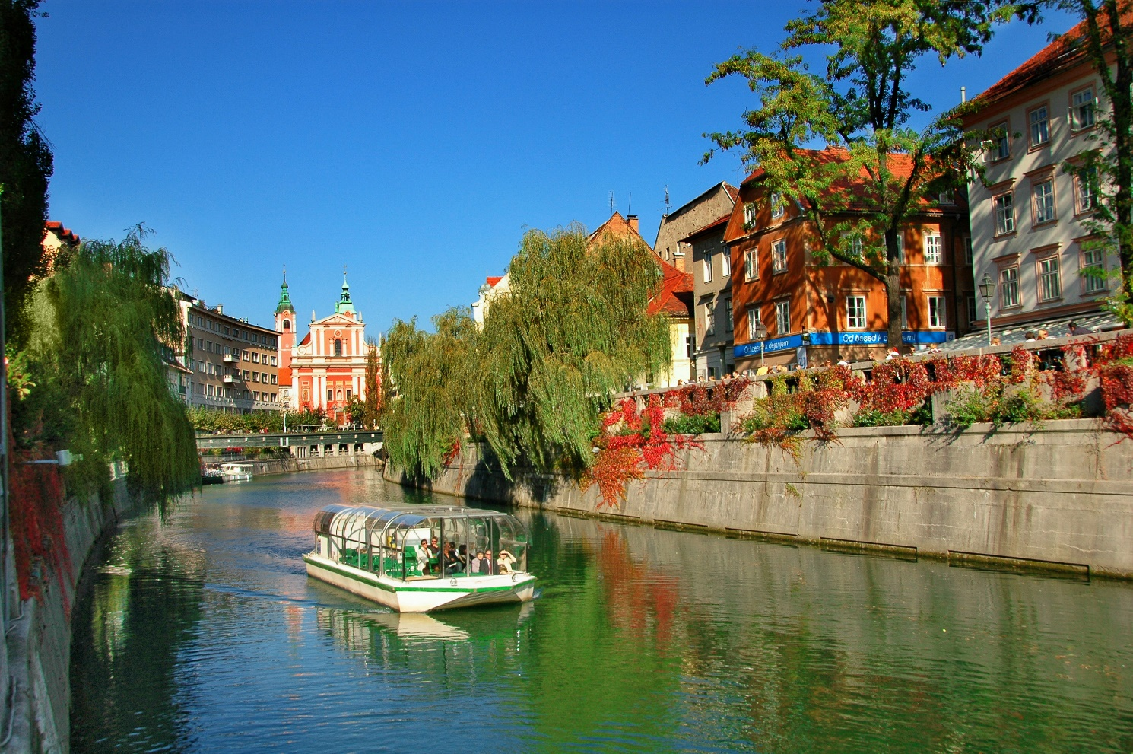
Being a Foreign Student in Slovenia
https://www.youtube.com/watch?v=WL83EFMZ51U

Slide 19
Presentation of Student Tutors
Tutor System

Slide 20
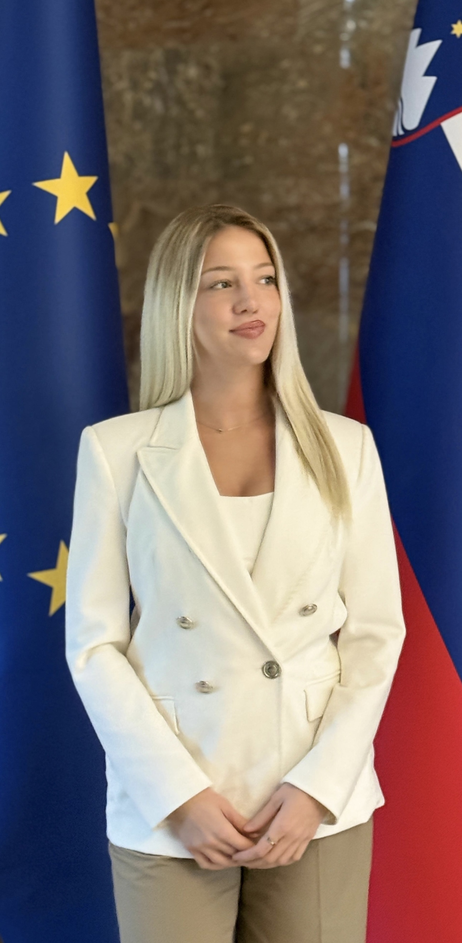
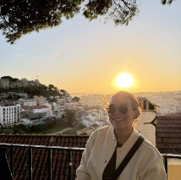
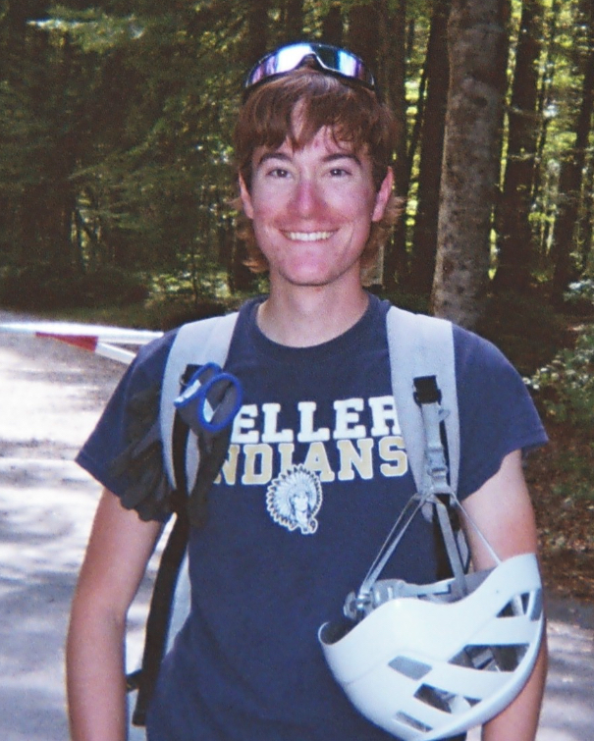
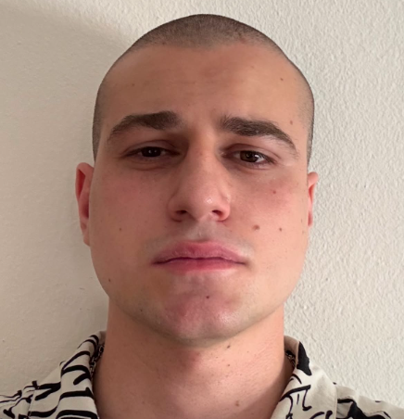
Student tutors
Anja Mitrović
Mail: anja.mitrovic26@gmail.com
Instagram: @anyamitrovic
Number: 069 806 608
Danica Filipović
Mail: filipovidanica23@gmail.com
Instagram: @filipoviicdanica
Number: 069 336 747
Tadej Race
Mail: tadejrace1@gmail.com
Instagram: @tadej_r
Number: 069 773 414
Ivan Halič
Mail: ivanhalic76@gmail.com
Instagram:@ivanhalic
Number:069 937 878

Slide 21
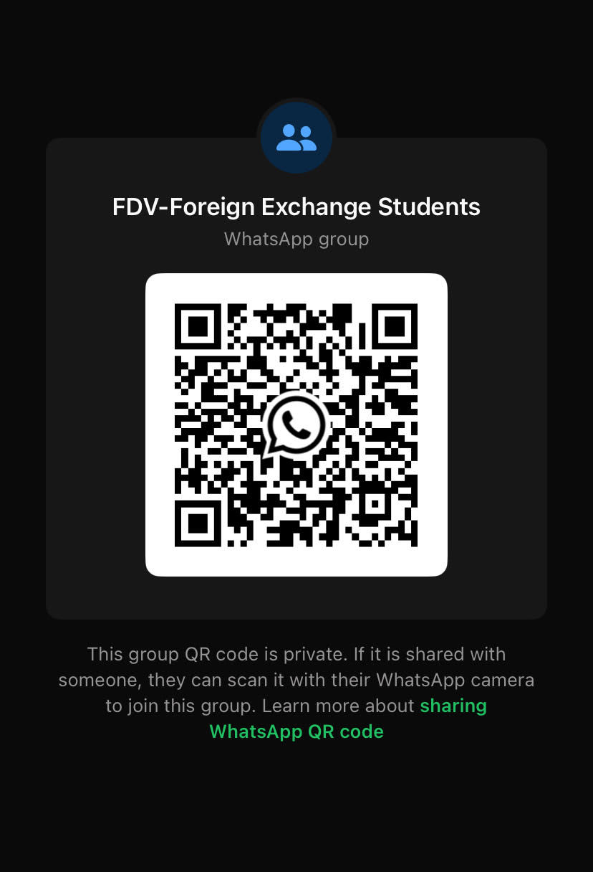
WhatsApp group with your tutors:
https://chat.whatsapp.com/KSzd105bShzIHiKOISexKB?s=cl&p=i&mlu=0&ilr=4

Slide 22





Thank you for your attention!

Slide 23
Specific Information for Exchange Students

Slide 24
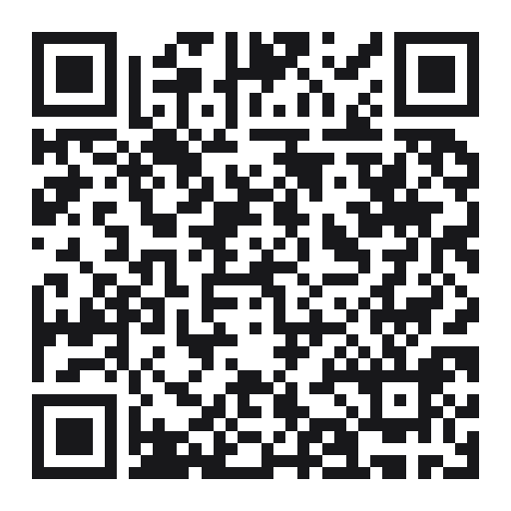
Attendance Confirmation
Scan the QR Code
–
First name
Last name
Email address

Slide 25
Outline
Courses at the Faculty of Social Sciences / other faculties
Timetable
The 3 documents
Drop Off Period
Office hours
Q&A

Slide 26
Courses of the Faculty of Social Sciences
Social, Cultural, Political and Communication Sciences
Courses

Slide 27
English for specific purposes/Introduction to the language for specific purposes – English
Italian for specific purposes I and II/Introduction to the language for specific purposes - Italian
French for specific purposes I and II/Introduction to the language for specific purposes - French
German for specific purposes I and II/Introduction to the language for specific purposes - German
Spanish for specific purposes I and II/ Introduction to the language for specific purposes – Spanish
REGISTRATION:
- write an email to dr. Nina Gorenc, Lector: nina.gorenc@fdv.uni-lj.si
- stating your level of knowledge and field of studies
Language courses

Slide 28
Courses at other faculties
Coordinators emails:
Faculty of Arts | Ms dr. Tjaša Ribizel Popič | mobility@ff.uni-lj.si
Faculty of Social Work | Mr Borut Petrović Jesenovac | office@fsd.uni-lj.si
Faculty of Law | Ms Lea Kremič | lea.kremic@pf.uni-lj.si
Faculty of Education | Mr Robert Gracar | mednarodna@pef.uni-lj.si
Faculties of the University of Ljubljana are very different entities:
  you will not see courses registered at other faculties in the MyFDV web office,
  all academic actions must be done by their international office / web office,
  at the end of your mobility you will receive a separate Transcript of Records.

Slide 29
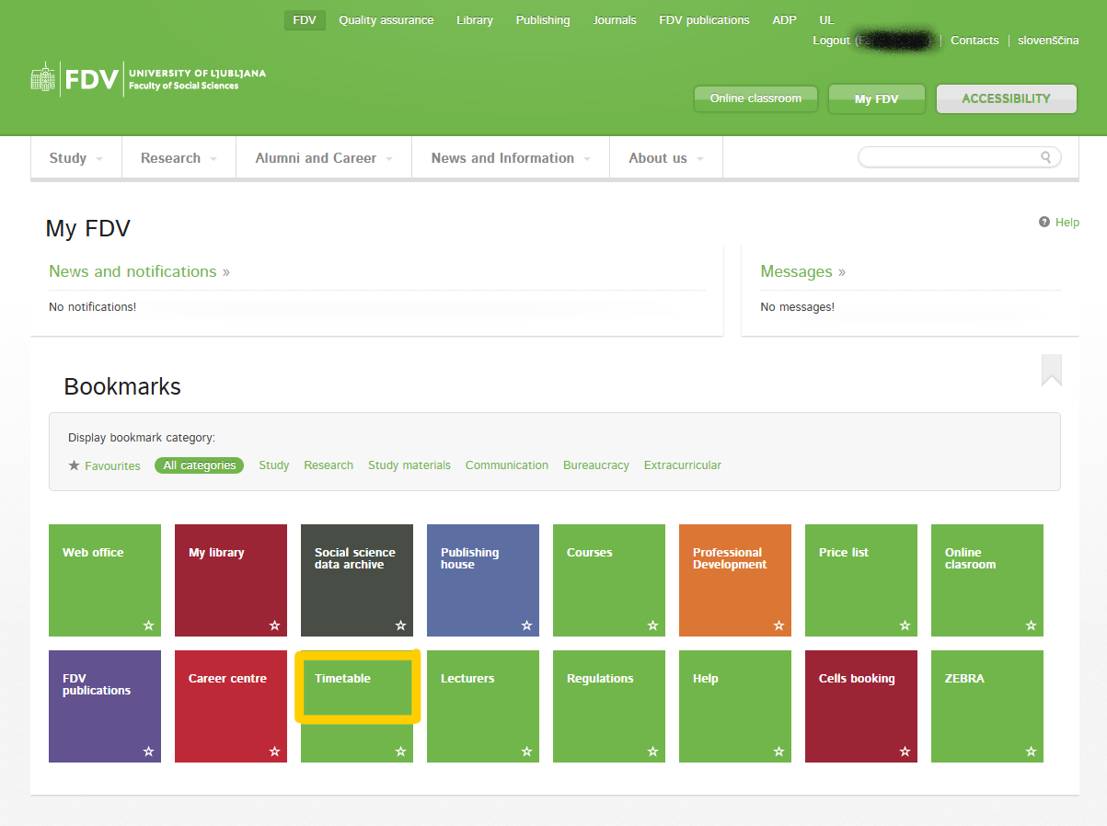
My FDV
„My FDV“
–
click „Timetable“

Slide 30
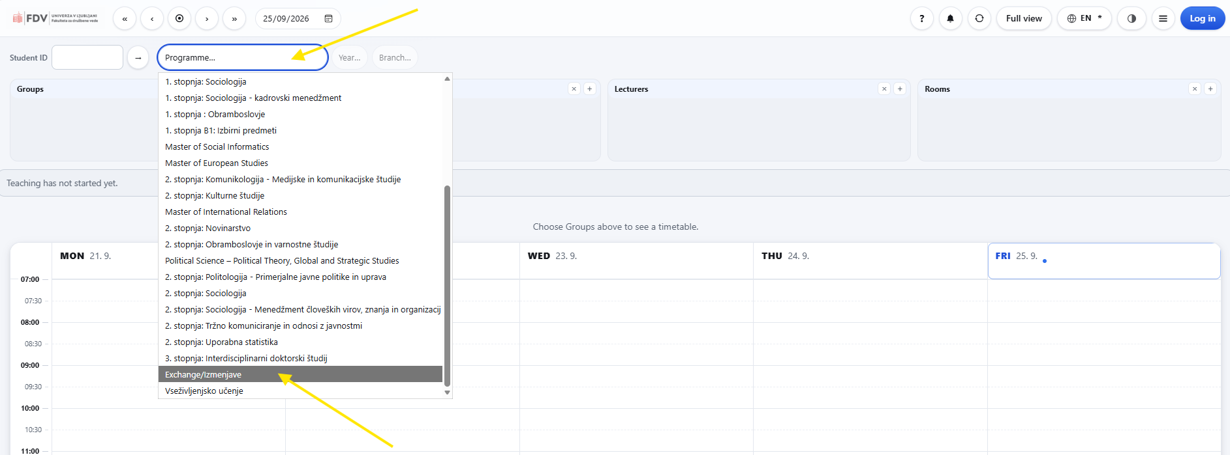
Timetable – Option 1
click the pop-up menu under „Programme“ section – scroll down and click „Exchange/Izmenjave“ = all bachelor and master level courses for mobility students will appear

Slide 31
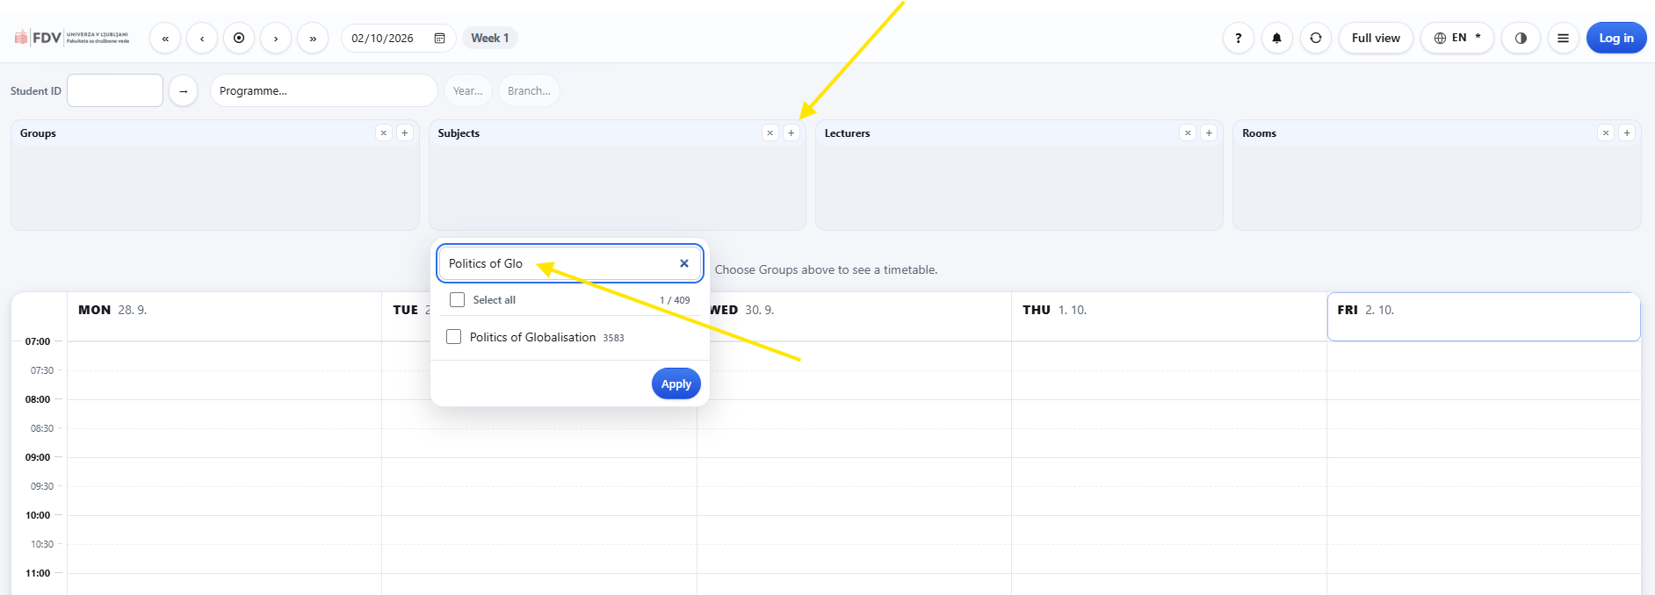
Timetable – Option 2
click the plus (+) under „Subjects“ section – a smaller window will open = type in a course‘s name = tick a course and click „Apply“

Slide 32
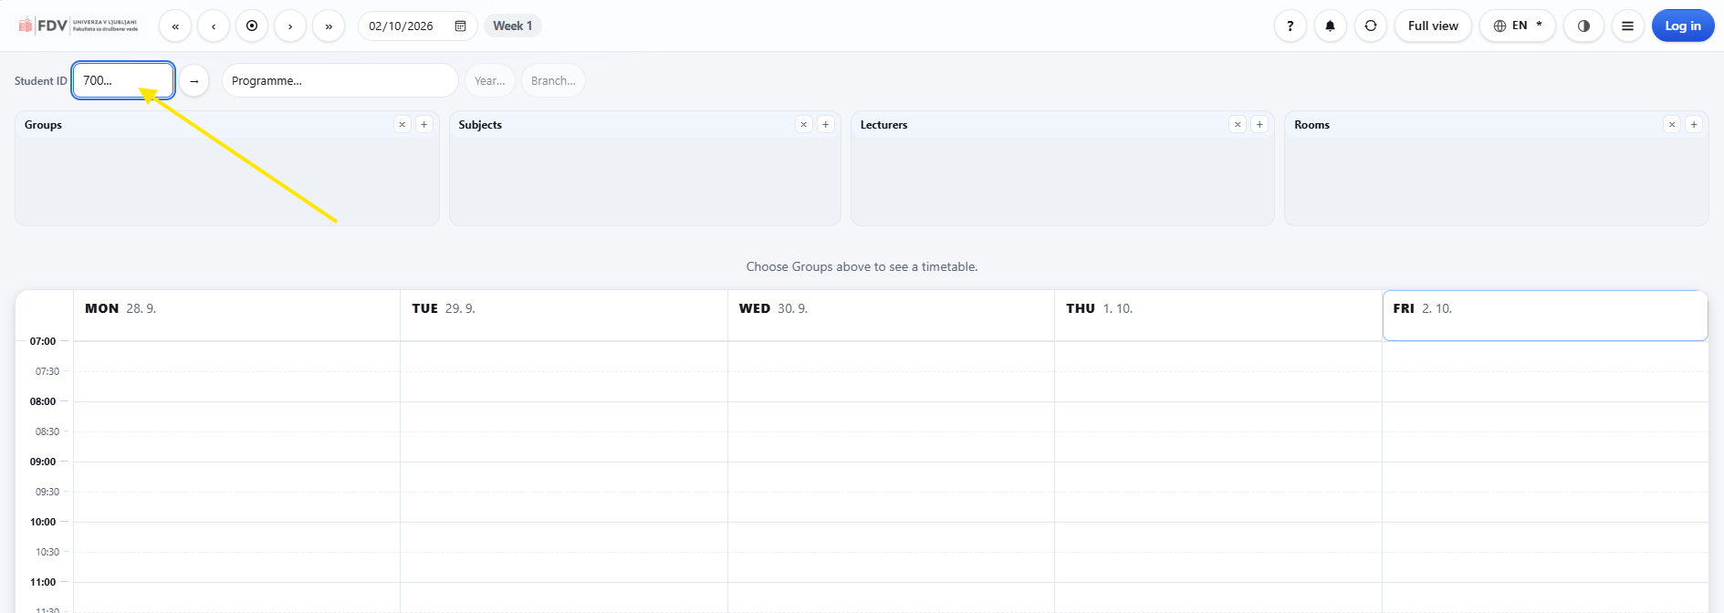
Timetable – Option 3
under „Student ID“ section – type in your enrollment number
(e.g. 70091234) + press enter = only courses you have registered for will appear

Slide 33
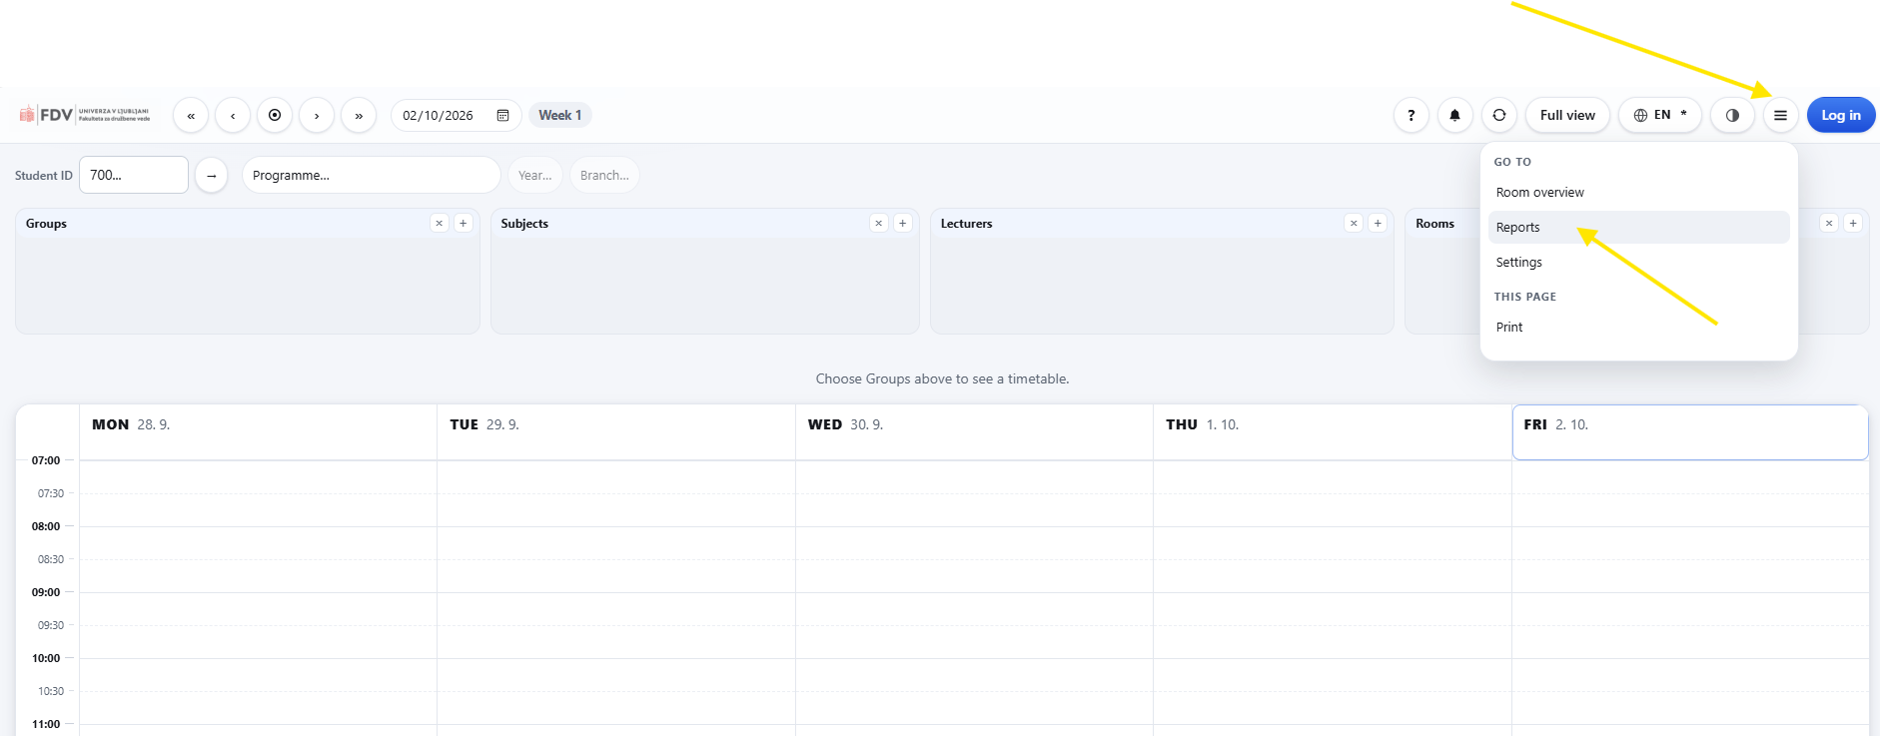
Timetable – Report
click the “three lines” in the right-hand side corner – in the pop-up menu click “Reports” = weekly plan for every course you are registered for

Slide 34
The 3 documents
THERE ARE ONLY THREE DOCUMENTS THAT NEED TO BE PROCESSED BEFORE / DURING / AT THE END OF YOUR MOBILITY
Online Learning Agreement (OLA) / Learning Agreement (LA)
Confirmation of Stay
Transcript of Records

Slide 35
1) Online Learning Agreement (OLA)
if you do not know how to make changes to your OLA, check with your home coordinator
when preparing OLA in your university‘s platform it is of utmost importance to use office.international@fdv.uni-lj.si email address – it is only this way that your OLA can be linked to our system for a review and signature
2) Learing Agreement (LA)
if you do not know how make changes to your LA, check with your home coordinator
send (unlocked!) pdf version to office.international@fdv.uni-lj.si – we will review and sign LA; a signed copy will be emailed back to you

Slide 36
Confirmation of Stay – 1
differently named documents: e.g. Confirmation of Stay / Confirmation of Studies / Letter of Confirmation / Certificate of Attendance / Confirmation of Attendance, Coonfirmation of Arrival/departure or similar
in case the document was not provided ask your home coordinator to provide you with the document
only in case your home coordinator does not provide with the document, we will hand out our version of the document
FILL OUT THE DOCUMENT IN FULL and send it to office.international@fdv.uni-lj.si

Slide 37
Confirmation of Stay – 2
Start date: Welcome and Orientation Day – 30th September 2026
(in case you took part in the Slovenian language course – 31st August 2026)
End date: 1st February 2027
in case you finish academic obligations earlier and plan to leave Ljubljana before the 1st February 2027, stop by our office one day prior or on the day of you departure
in case you finish your academic obligations later than 1st February 2027, stop by our office one day prior or on the day of your departure

Slide 38
Transcript of Records
go to My FDV
–
click „Web office“

Slide 39
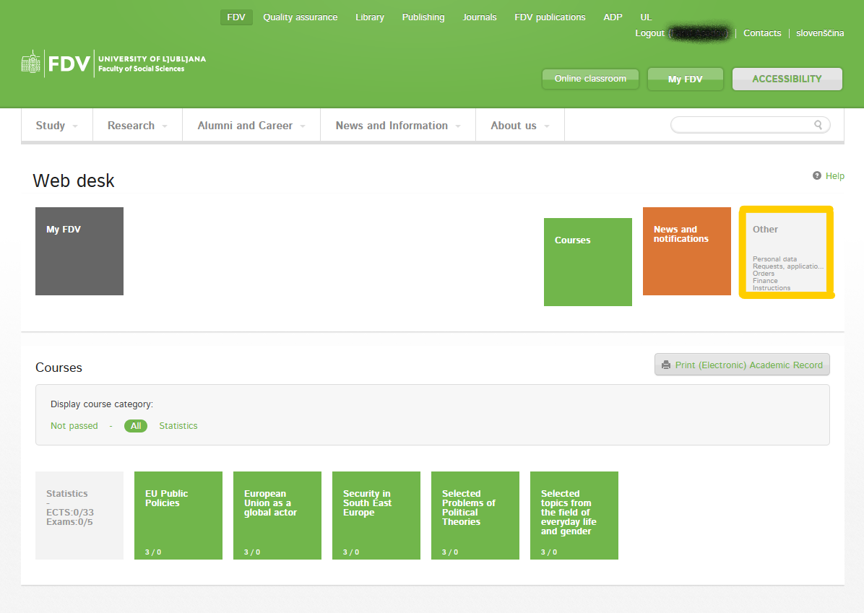
Transcript of Records
click „Other“

Slide 40
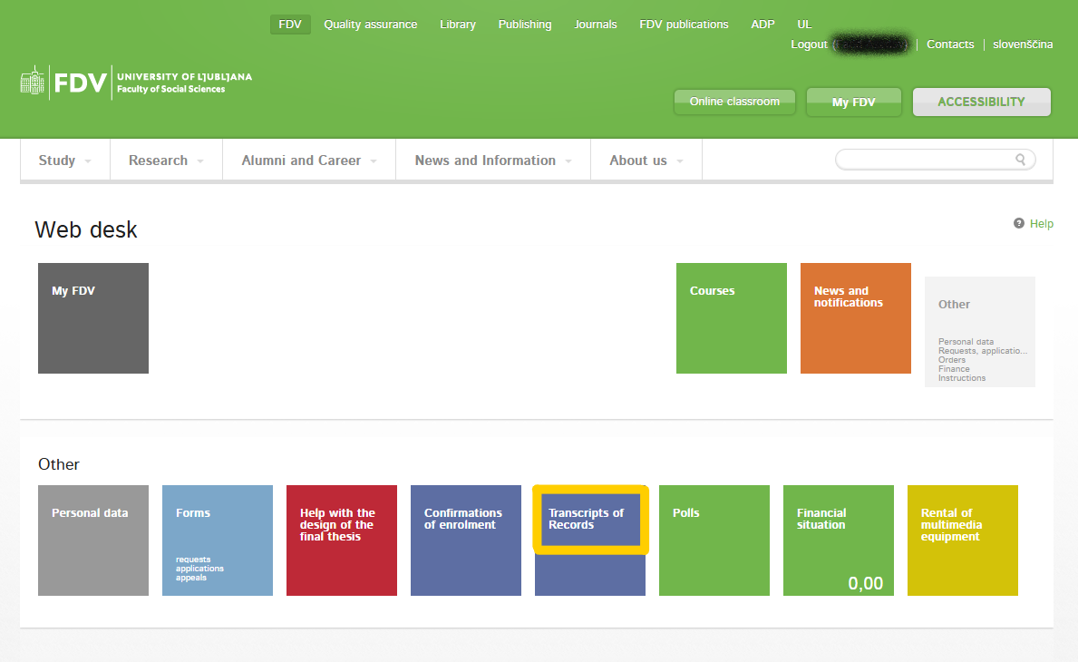
Transcript of Records
once you complete all exams you can retrieve Transcript of Records directly from web office –
click „Transcript of Records“

Slide 41
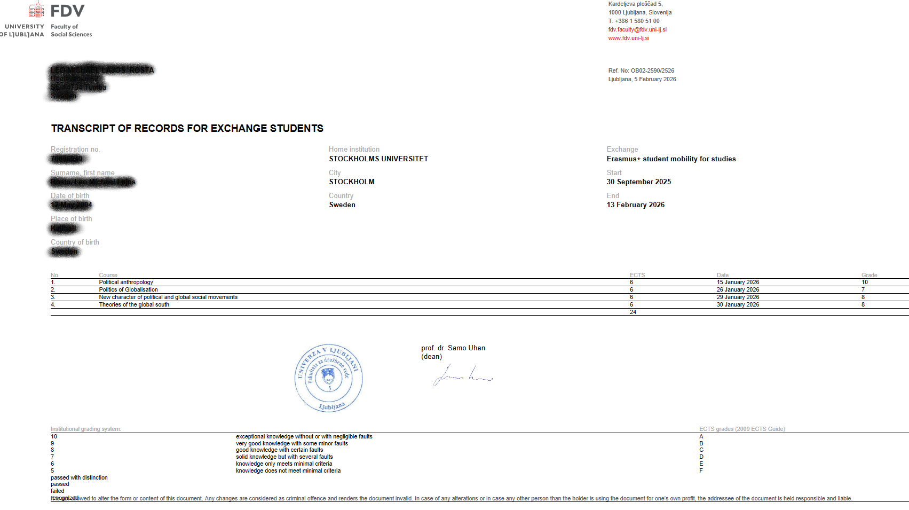
Transcript of Records
in case your home institution requires ToR to be sent directly from our to their office
–
provide us with the email address to which ToR should be sent to

Slide 42
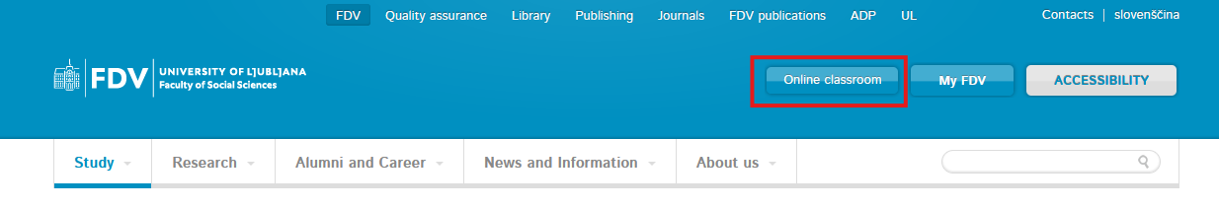
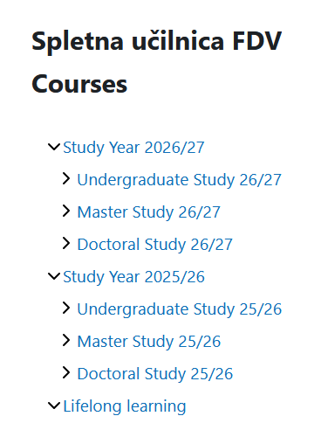
Online classroom - Moodle
Access to the Moodle environment is granted using your UL digital identity.
Access to individual course classrooms requires a key/code, which is provided by the course holder.
Notes:
At the begining of the courses the course holder will give you the code / the key to access to individual course classrooms. It is not the same password as UL DI!

Slide 43
DROP-OFF PERIOD: How to make changes to your LA?
The courses you currently have in your MyFDV web office are confirmed and places are guaranteed
You can change the confirmed courses from 2 October 00:00 (CET) until 8 October 23:59 (CET) - via your MyFDV web office (explained later)
No further course changes can be made after the deadline!

Slide 44
DROP-OFF PERIOD: How to make changes to your LA?
ADD A COURSE
DELETE A COURSE
CHANGE A COURSE

Slide 45
DROP-OFF PERIOD: How to make changes to your LA?
open the website
–
Faculty of Social Sciences
–
click
„My FDV“

Slide 46
DROP-OFF PERIOD: How to make changes to your LA?
click „All categories“

Slide 47
DROP-OFF PERIOD: How to make changes to your LA?
click „Web office“

Slide 48
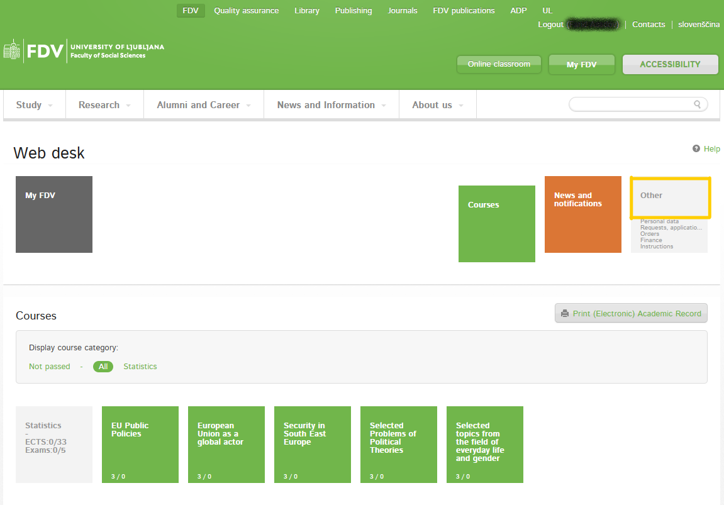
DROP-OFF PERIOD: How to make changes to your LA?
click „Other“

Slide 49
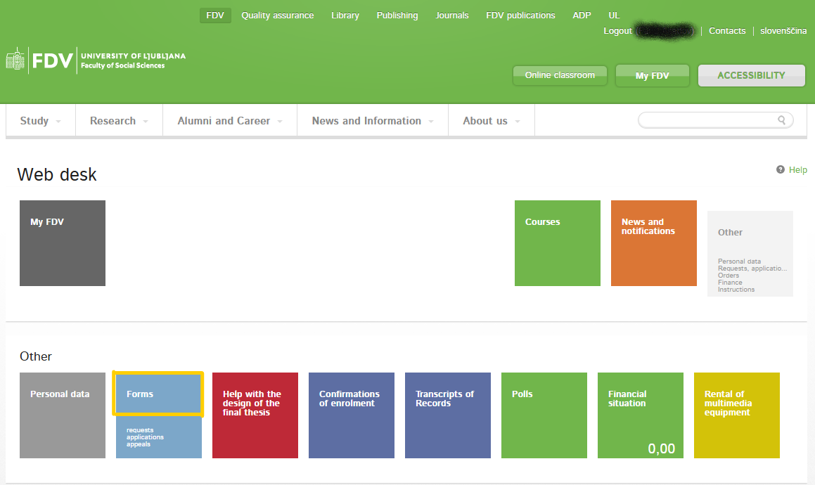
DROP-OFF PERIOD: How to make changes to your LA?
click „Forms“

Slide 50
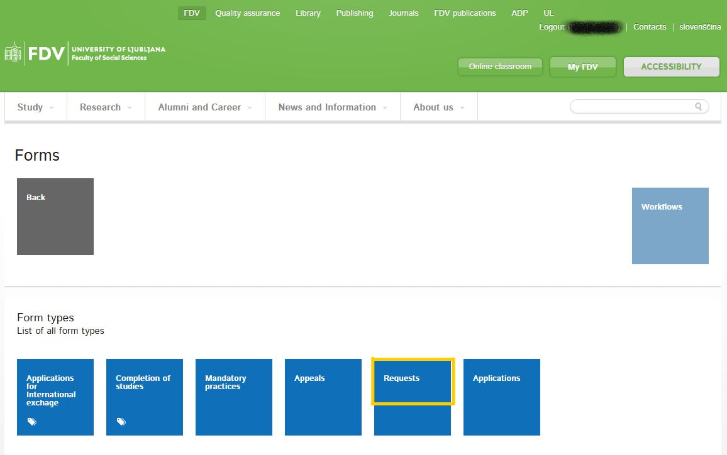
DROP-OFF PERIOD: How to make changes to your LA?
click „Requests“

Slide 51
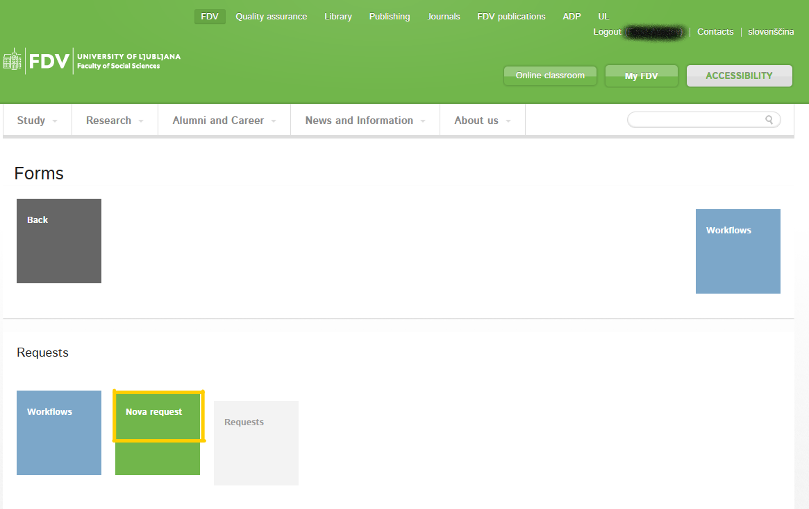
DROP-OFF PERIOD: How to make changes to your LA?
click „Nova request“

Slide 52
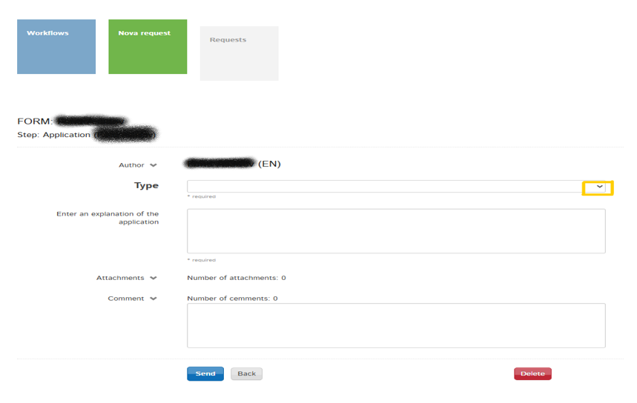
DROP-OFF PERIOD: Replacement of a course
click the arrow to
open the menu

Slide 53
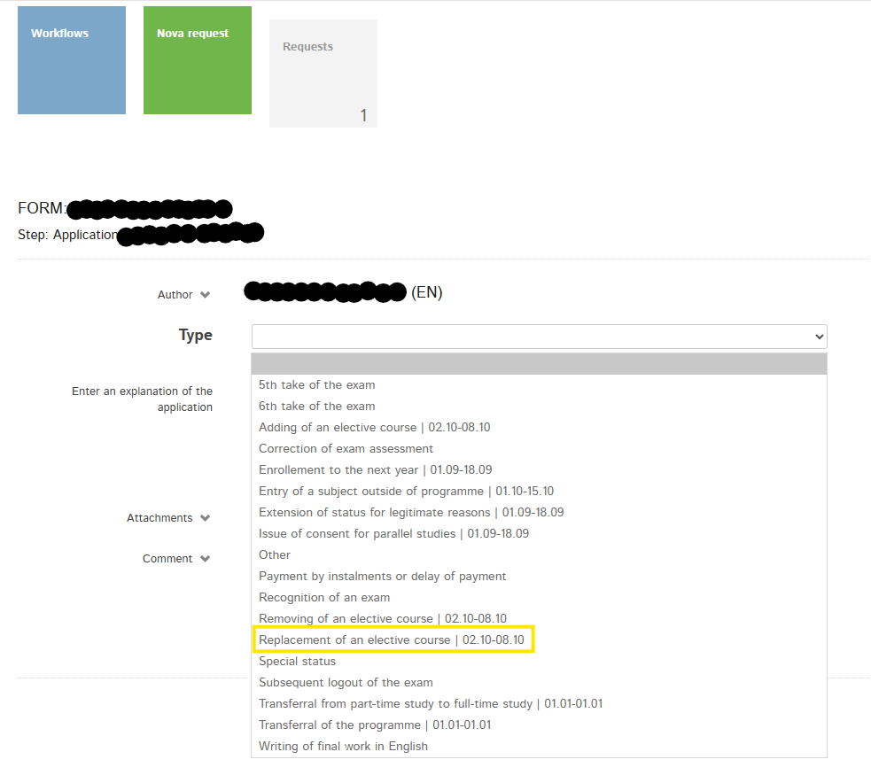
DROP-OFF PERIOD: Replacement of a course
click
„Replacement of an
elective course“

Slide 54
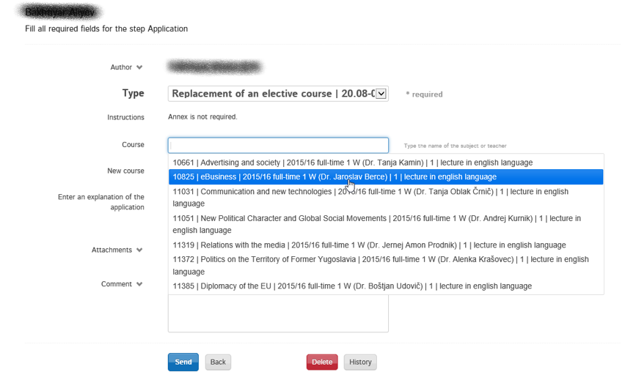
DROP-OFF PERIOD: Replacement of a course
in the „Course“ menu
–
click the course you
would like to replace

Slide 55
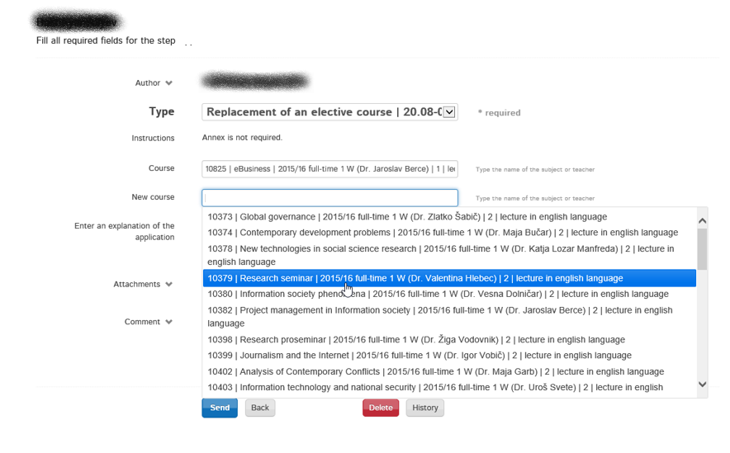
DROP-OFF PERIOD: Replacement of a course
in the „New course“ menu
–
select a new course
–
click „Send“

Slide 56
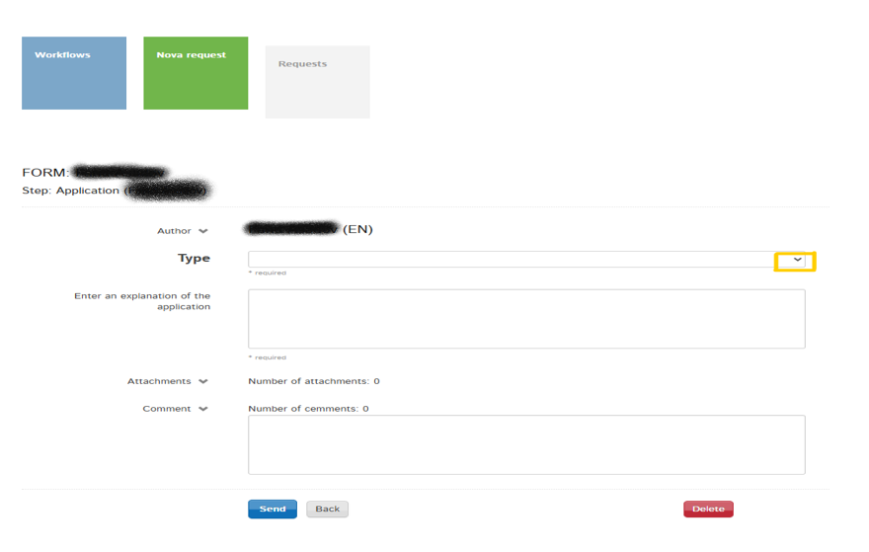
DROP-OFF PERIOD: Removing/deleting a course
click the arrow to
open the menu

Slide 57
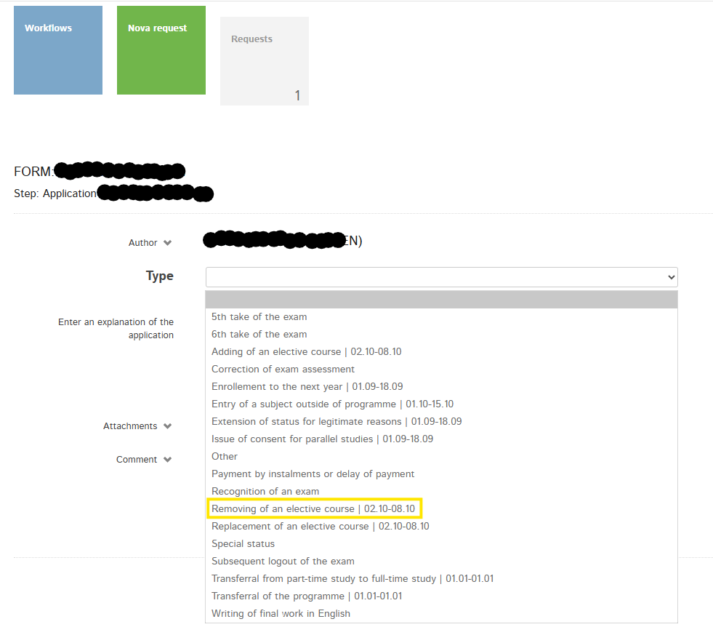
DROP-OFF PERIOD: Removing/deleting a course
click
–
„Removing of an
elective course“

Slide 58
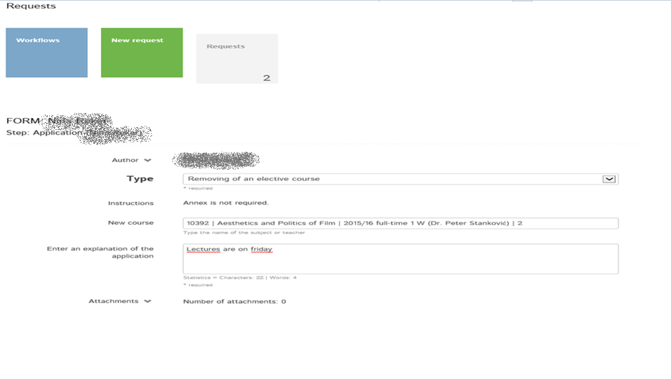
DROP-OFF PERIOD: Removing/deleting a course
in the „New course“ pop-up menu
–
click the course you would like to delete
–
click „Send“

Slide 59
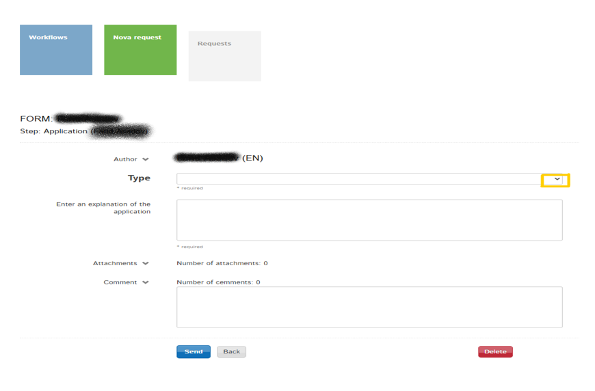
DROP-OFF PERIOD: Adding a course
click the arrow to
open the menu

Slide 60
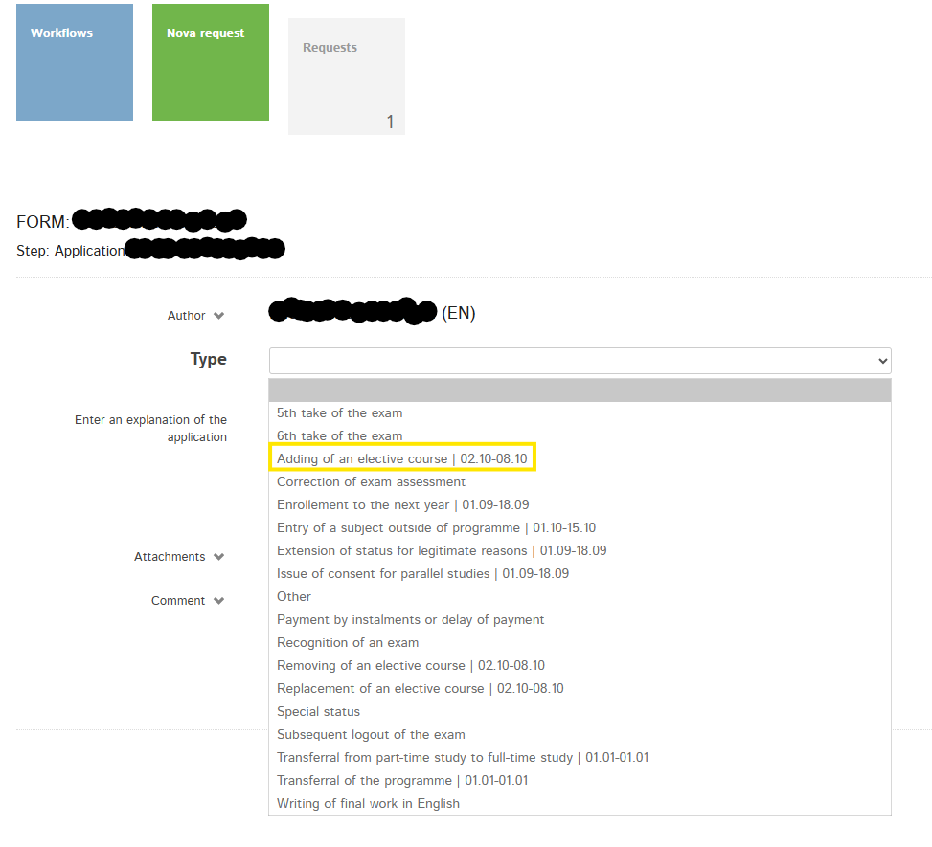
DROP-OFF PERIOD: Adding a course
click
–
„Adding of an
elective course“

Slide 61
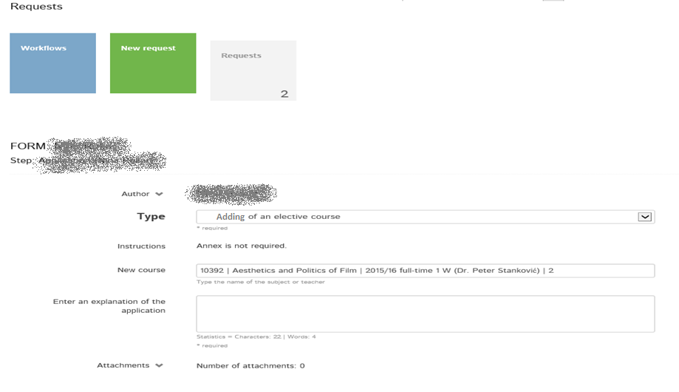
DROP-OFF PERIOD: Adding a course
in the „New course“ pop-up menu
–
click the course you would like to add
–
click „Send“

Slide 62
MA courses opened to BA students
COURSE TITLE | ECTS | STUDY LEVEL | LECTURER
Analysis of Contemporary Conflicts | 6 | Postgraduate (master) | prof. dr. GARB, Maja
Comparative Interest Group Politics | 6 | Postgraduate (master) | prof. dr. NOVAK, Meta
Contemporary Development Problems | 6 | Postgraduate (master) | doc. dr. HOČEVAR, Marko
Contemporary Issues in Political Science | 10 | Postgraduate (master) | prof. dr. VODOVNIK, Žiga
Corporate Governance | 8 | Postgraduate (master) | prof. dr. RUS, Andrej
Diplomacy | 5 | Postgraduate (master) | prof. dr. UDOVIČ, Boštjan
Environmental Sociology | 6 | Postgraduate (master) | prof. dr. URŠIČ, Matjaž
European Union Development | 5 | Postgraduate (master) | izr. prof. dr. LOVEC, Marko
Future Studies | 6 | Postgraduate (master) | izr. prof. dr. MAJSOVA, Natalija
Gender, Work and Organisations | 8 | Postgraduate (master) | izr. prof. dr. KANJUO-MRČELA, Aleksandra
Ideologies | 9 | Postgraduate (master) | prof. dr. VODOVNIK, Žiga
International Conflict Management | 5 | Postgraduate (master) | prof. dr. ROTER, Petra
Political Economy of Journalism | 9 | Postgraduate (master) | izr. prof. dr. AMON PRODNIK, Jernej
Security and Defence Policy of the EU | 6 | Postgraduate (master) | izr. prof. dr. JUVAN, Jelena
Security Studies and Security Policy | 6 | Postgraduate (master) | prof. dr. ZUPANČIČ, Rok
Social Sciences Research Methods | 3 | Postgraduate (master) | prof. dr. HLEBEC, Valentina
Theories of European Integration | 6 | Postgraduate (master) | prof. dr. POŽGAN, Jure
Trends and Contemporary Challenges in Marketing Communication and Public Relations | 6 | Postgraduate (master) | doc. dr. UZUNOGLU, Ebru

Slide 63
DROP-OFF PERIOD
after you have submitted your request, all requests will be processed by the International Exchange Office
as this process takes some time, you will not receive an immediate response, but as soon as all requests have been processed (appropriately by 13th October 2026 at the latest)
we will NOT send out new (O)LAs automatically, you will have to prepare them yourself after the Drop-Off Period!

Slide 64
Information you need to memorize
Responsible person at the receiving institution:
Name: Zoran Pečar
Position: Student Mobility Coordinator
Email: office.international@fdv.uni-lj.si
Phone: 00386 (0)1 5805 279
Office hours: Monday, Wednesday, Friday: 11.00 – 13.00
Office location: DS-01 (on the subterrene level)

Slide 65
We wish you a remarkable semester full of stories, knowledge and new friendships!

