Slide 1


INFORMATION DAY FOR STUDY EXCHANGES
DECEMBER 2025

Slide 2
1. GAINING INTERNATIONAL EXPERIENCE DURING YOUR STUDIES
Study exchange abroad
Erasmus traineeship abroad

Slide 3

Why seek international experience?

Slide 4

Soft skills – personal and professional development
Development of intercultural competencies
Improving language skills
Personal growth and independence
Greater motivation, self-confidence, and proactivity
Loss of fear of the unknown, openness to new cultures
Flexibility and problem-solving skills
Communication skills (formal and informal settings)
International network of friends – “Erasmus family”
Social intelligence and cooperation in different environments

Slide 5
Academic/study development
Access to different pedagogical approaches and learning methods
Access to courses that are not available at home institution
Expanding academic profile and acquiring interdisciplinary knowledge
Opportunity to participate in projects, research groups, or internships
Participation in international classrooms (global perspectives)
Development of academic writing in a foreign language
Greater competitiveness for further study (e.g., master's/doctoral programs)

Slide 6
Other advantages - life, career, and social benefits
Traveling, exploring the world, gaining new experiences
New habits, routines, and broader insight into a globally connected world
An invaluable life experience that shapes personal identity
Networking with people from all over the world
Long-term development of a global network that can lead to future collaborations
Employers value international experience – proof of flexibility, independence, intercultural and language skills
The job market is becoming increasingly global, and international experience is a major advantage
Developing broader social responsibility and understanding of global challenges

Slide 7

2. TERMS OF EXCHANGE, PROCEDURES AND INFORMATION

Slide 8
Calls for applications for the academic year 2026/27
Calls for applications published on the FDV website → Study abroad → Announcements
Three calls for applications for the eligible period between June 1, 2026, and September 30, 2027:
1. Erasmus+ mobility for study purposes (SMS)
  2. Erasmus+ trainsheep mobility (SMP) (open applications)
  3. Exchanges through bilateral agreements (outside the EU):
Notes:
Explain the stars on the tables…

Slide 9
Conditions for Erasmus+ study exchange
During the exchange, you must have an active student status, no outstanding financial obligations, and no disciplinary sanctions.
Duration → minimum 2 months and maximum 12 months at each level of study (except in the case of short-term doctoral mobility)
If you have already been on an exchange → the total mobility period is a maximum of 12 months or 360 days per individual study level.
Students must obtain and have at least 20 ECTS credits recognized at home institution for one semester or at least 40 ECTS credits for full study year mobility (30/60 ECTS credits recommended).

Slide 10
Choosing a host university
FDV has over 200 Erasmus+ bilateral agreements or contracts (bilateral contracts) with partner universities.
Careful choice of university:
  field of study (within your department)
  subjects for exchange in relation to subjects at the Faculty of Social Sciences
  the language of lectures and other details can be found on their websites
List of universities listed in the call for applications
Notes:
Students who completed practical training abroad under the Erasmus or Erasmus+ program by 2015-16, but not for the full 12 months, are eligible to apply for this call. The total duration of studies and training already completed and requested may not exceed 12 months per individual level of study.

Slide 11
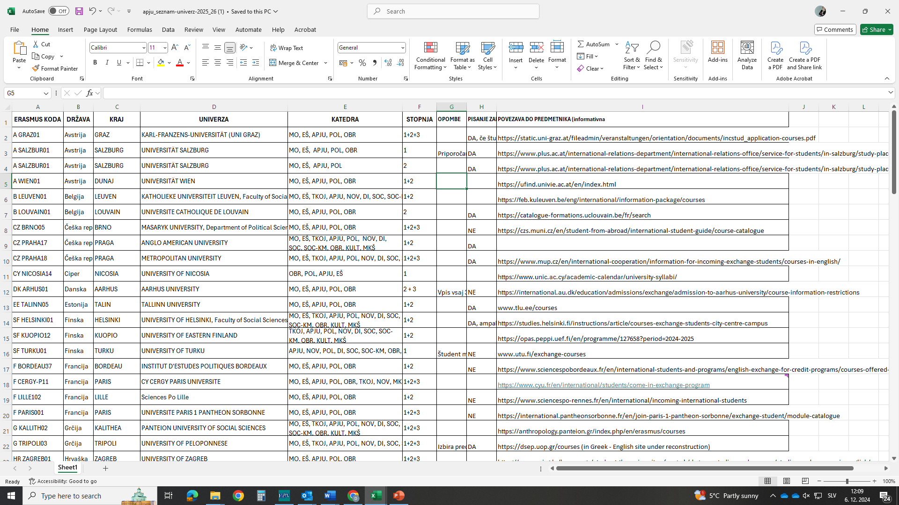
Example of a table of available universities
IMPORTANT:
  The information in columns G to I is for informational purposes only. Students should verify the information themselves before applying. They should also check the required language certificates.
Notes:
Students who completed practical training abroad under the Erasmus or Erasmus+ program by 2015-16, but not for the full 12 months, are eligible to apply for this call. The total duration of studies and training already completed and requested may not exceed 12 months per individual level of study.

Slide 12
Writing the final thesis
Application via the Erasmus+ study call
DIFFERENCE:
You do not take courses during the exchange (you do not obtain ECTS credits)
Shorter mobility: 2 or 3 months (by agreement with the host university)
IMPORTANT:
  not every partner university offers this option, so students must check in advance before applying,
  it is recommended to seek the assistance of a professor abroad, but this is not mandatory and depends on the conditions of the foreign university (this is not a co-supervisor!),
  the mentor and the topic of the final thesis must be registered at the Faculty of Social Sciences before departure for this type of mobility.

Slide 13
Conditions for bilateral student exchange
You must have an active student status during the exchange period.
We invite students with the following qualifications to apply:
  good average grade (in accordance with the conditions of the foreign university)
  very good command of a foreign language (in accordance with the requirements of the foreign university, an internationally recognized language certificate is required – IELTS, TOEFL, DELE, etc.)
The FDV only conducts the selection process and nominates selected students to the host university. All other procedures must be arranged by students themselves (obtaining a scholarship, arranging a visa, arranging health insurance, etc.).
Confirmation from a foreign institution = approval of exchange
At a foreign university, students are exempt from tuition fees, but the logistical costs are significantly higher than for an Erasmus+ exchange.

Slide 14
Basic conditions for Erasmus+ internships
  CALL FOR APPLICATIONS: https://www.fdv.uni-lj.si/studij/studij-v-tujini/obvestila/razpis-smp-za-erasmus-fizi%C4%8Dno-kombinirano-mobilnost-%C5%A1tudentov-z-namenom-prakti%C4%8Dnega-usposabljanja-v-%C5%A1t.-letu-2025-2026
  Students look for an employer themselves, some useful information can also be found here: (links for finding internships - HERE - and at the UL Career Center.)
  the internship must be related to the student‘s field of study
  application for an internship with completed documentation 1 month before the desired start date of the internship
  Young graduates – applications before completing their studies (i.e., before the final exam or before submitting/defending the master's/doctoral thesis + completion within 12 months of application) – Student status alone is not sufficient for application!

Slide 15
Learning Agreement
The central document for an exchange
The document can be found at FDV/Study/Study abroad/Forms.
  Digital Learning Agreement
Signed by all three parties and uploaded to the UL online application at least 10 days before the start of mobility, otherwise it will not be possible to receive the Erasmus+ grant or any other additional funds.
Please address any questions regarding content to the representative of the department for international cooperation: Representatives of departments for international cooperation (uni-lj.si)
Please address procedural questions to the FDV International Office: office.international@fdv.uni-lj.si

Slide 16
Erasmus+ financial support in the 2025 project year
Group 1 | Austria, Belgium, Denmark, Finland, France, Ireland, Iceland, Italy, Germany, Liechtenstein, Luxembourg, Germany, Netherlands, Norway, Sweden | 674 €
Group 2 | Cyprus, Czech Republic, Estonia, Greece, Latvia, Malta, Portugal, Slovakia, Spain | 606 €
Group 3 | Bulgaria, Croatia, Lithuania, Hungary, North Macedonia, Poland, Romania, Serbia, Turkey | 550 €

Slide 17

Additional Support for Inclusion
250 EUR/a month
CONDITION: the student receives a state scholarship or the student is a member of a family where one of the children or parents has a decision from the CSD/ ZZZS/ZRSŠ decision, or the student itself has a ZRSŠ/CSD/ZZZS decision (companion, adjustment of teaching, disability, etc.), or the student comes from a single-parent or foster family, or if Slovenia offers the student international protection, or the student is a representative of the Roma community.
Green Travel Supplement
EUR 50 (one-off allowance)
CONDITION: travel to and from the place of mobility by bus, train, boat, and/or other group transport (e.g., GoOpti, etc.).

Slide 18
Erasmus+ financial support in the 2025 project year
DISTANCE TO MOBILITY LOCATION (CALCULATION WITH THE EU DISTANCE CALCULATOR) | STANDARD TRAVEL (PAYMENT PER PARTICIPANT) | GREEN TRAVEL + UP TO 6 ADDITIONAL DAYS FOR TRAVEL * (PAYMENT PER PARTICIPANT)
between 10 and 99 km | 28 € | 56 €
between 100 and 499 km | 211 € | 285 €
between 500 and 1999 km | 309 € | 417 €
between 2000 and 2999 km | 395 € | 535 €
Between 3,000 and 3,999 km | 580 € | 785 €
between 4,000 and 7,999 km | 1188 € | 1188 €
8,000 km or more | 1735 € | 1735 €
EU DISTANCE CALCULATOR: https://erasmus-plus.ec.europa.eu/resources-and-tools/distance-calculator
* (e.g., bus, train, group transport (minibus), ship transport).

Slide 19

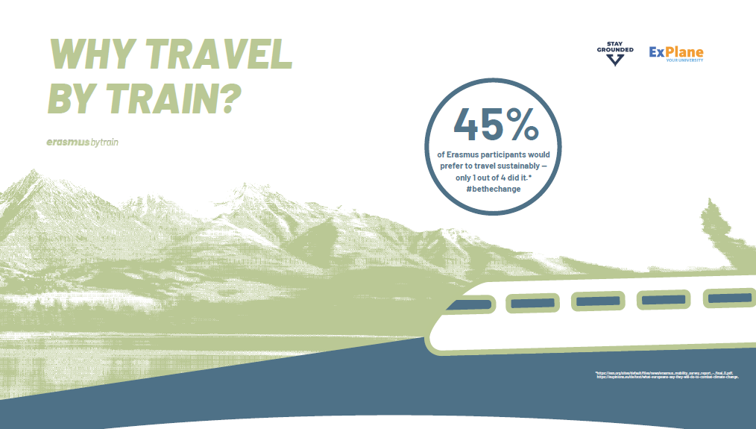



https://www.interrail.eu/en/interrail-passes/erasmus

Slide 20
3. APPLICATIONS and SELECTION

Slide 21
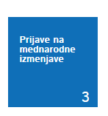
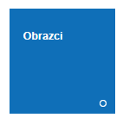


Registration until January 4, 2026
Registration via the MyFDV web office → PAY ATTENTION TO THE PREVIOUS SESSION → PREPARE THE CONTENT IN ADVANCE!
Applications are submitted directly via the MyFDV online portal! The portal allows you to select up to 5 foreign universities!

Slide 22
Motivational letter in English
Instructions
  Motivational Letter in English language
  all answers for all choices of your study exchange
  base your letter on your coursework and your interest in a particular university; do not write general facts.
Questions
  For each foreign university, make a list of at least four courses – for at least 20 ECTS (preferably more – at least 30 ECTS) – that you would like to register at host univeeristy and that simultaneously correspond with your study program at the Faculty of Social Sciences.
  For each subject, state why it is personally important to you, i.e., what competence or learning outcome you expect to gain. State this separately for each university.
  Explain your choice of foreign university, listing its advantages and why you find the chosen university particularly interesting. List this separately for each university.
  Would you like to add anything else about your choice of foreign university (optional)?
Notes:
Tukaj povej kako bo ocenjeno…

Slide 23
Selection process
A complete application includes an application form with a cover letter in English → submitted to the MyFDV web office
Ranking points (maximum 20 points):
  Motivational letter – 0 to 10 points – assessed by departmental representatives for international cooperation
  Average grade – 0 to 10 points
If there are more applications than places available at a particular university, the scoring will be taken into account. If the score is same for two (or more) students, we will conduct a selection interview together with departmental representatives for international cooperation.
A student is issued a positive/negative decision approving/rejecting the exchange.
APPROVED MOBILITY AT FDV DOES NOT NECESSARILY MEAN APPROVED FUNDING!
Notes:
Tukaj povej kako bo ocenjeno…

Slide 24
Časovnica
4. January 2026
13. February 2026
spring/ fall 2026
deadline for submitting your application form
We forward the applications of selected students to the International Exchange Office at the University of Ljubljana
We nominate students to the host university
The host university contacts the student and provides them with information about applying to the university (as well as information about accommodation and other practical matters).
Students receive the selection decision
UL Timeline : Timeline - University of Ljubljana (uni-lj.si)

Slide 25
Postopek izvedbe izmenjave
FDV
UL
Foreign institution
The PROCESS takes place at THREE institutions in THREE phases
1. phase
Before going abroad
2. phase
During your stay abroad
3. phase
After arriving from abroad

Slide 26

QUESTIONS?
Office hours: Mon. - Fri. from 11 a.m. to 1 p.m.
E-mail: office.international@fdv.uni-lj.si / TEL: 01/580-5-279
THANK YOU FOR YOUR ATTENTION! ☺

