Slide 1

Welcome to Ljubljana!
ESN Ljubljana

Slide 2
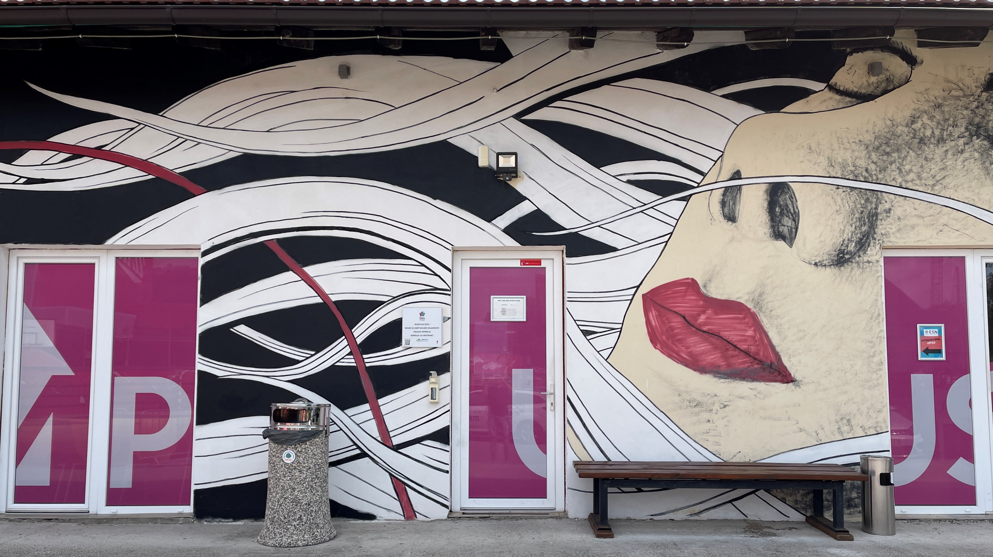

Location of our office lokacija naše pisarne
Študentski kampus, Pivovarniška ulica 6, 1000 Ljubljana

Slide 3
What does our office provide?
Kaj vam nudi naša pisarna?
subsidized student meals system
sistem subvencionirane študentske prehrane
private student accommodation search help
pomoč pri iskanju namestitve pri zasebnikih
document support
pomoč pri izpolnjevanju in zbiranju potrebnih dokumentov
events and trips registration
zbiranje prijav za udeležbo na dogodkih in izletih
ESN card provider
ponudnik kartice ESN
help with any other matter regarding your stay or education in Slovenia
pomoč glede vseh preostalih morebitnih izzivov povezanih z bivanjem in študijem v Sloveniji

Slide 4

Subsidized student meals system
Sistem subvencionirane študentske prehrane
EMŠO number (Unique personal identification number)
EMŠO številka
First enrollment: https://www.studentska-prehrana.si/en/Account/Register
Registracija: https://www.studentska-prehrana.si/en/Account/Register
mobile phone
mobilni telefon
mobile APP – Student meal APP (iOS) & Študentska prehrana (Google Play)
mobilna aplikacija - Student meal APP (iOS) & Študentska prehrana (Google Play)
personal ID or passport
osebni dokument ali potni list

Slide 5
Private student accommodation
Namestitev pri zasebnikih
our accommodation email address: rooms@sou-lj.si
naš elektronski naslov za namestitve: rooms@sou-lj.si
ESN Ljubljana Telegram private accommodation chat: https://t.me/+o6tq3s8bWJdhODdk
ESN Ljubljana Telegram pogovor o zasebnih namestitvah: https://t.me/+o6tq3s8bWJdhODdk
websites and Facebook groups: https://linktr.ee/accommodationljubljana
spletne strani in Facebook skupine: https://linktr.ee/accommodationljubljana
price
cena
University accommodation website: www.uni-lj.si/study/information/accommodation
univerzitetna spletna stran za namestitve: www.uni-lj.si/study/information/accommodation

Slide 6
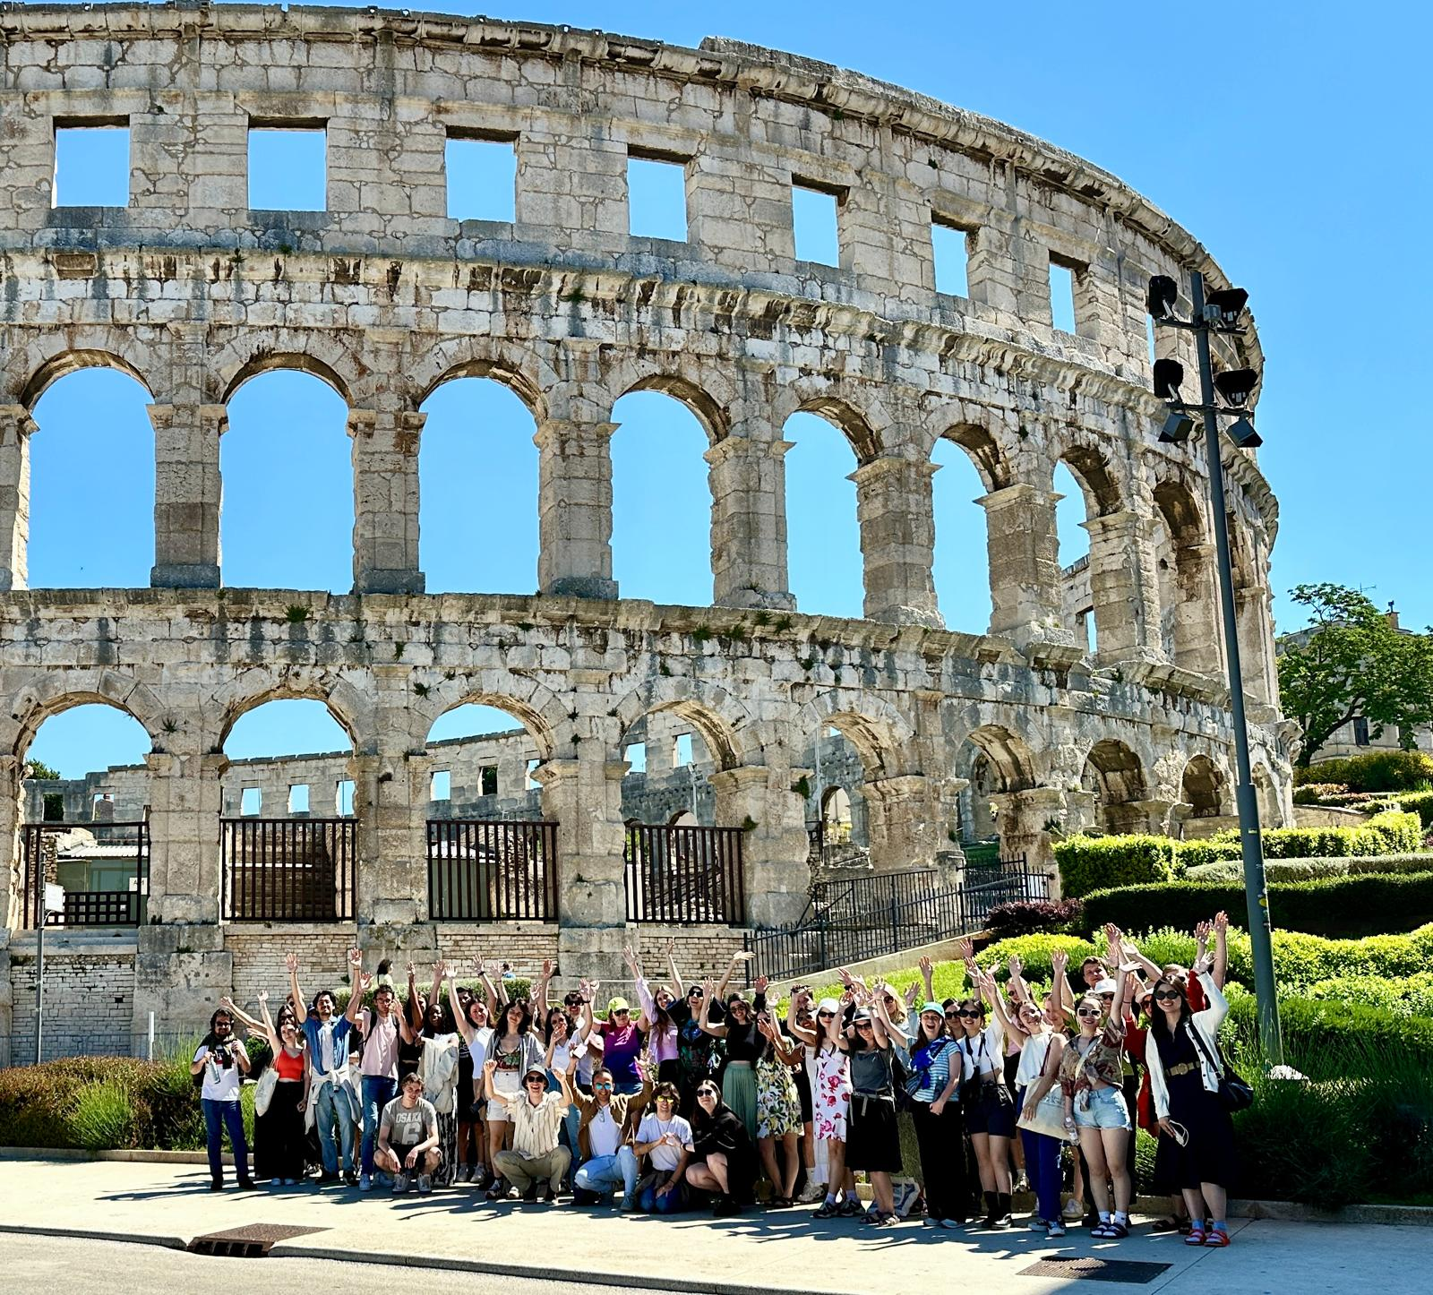
Events and trips
Dogodki in izleti
Welcome weeks
Tedni dobrodošlice
educational workshops and lectures
izobraževalne delavnice in predavanja
sports events and attendance of sports competitions in Ljubljana
športni dogodki in obisk le teh v Ljubljani
one-day events
enodnevni dogodki
one-day and multi-day excursions around Slovenia and Europe
enodnvene in večdnevne strokovne ekskurzije po Sloveniji in Evropi

Slide 7
Trips itinerary
Koledar izletov
07.02.2026 – Alpine trip – SOLD OUT
11.02.2026 – Ski trip to Kope – SOLD OUT
14.02.2026 – Lake trip – SOLD OUT
21.02.2026 – Coast trip – LAST SPOTS AVAILABLE
28.02. – 01.03.2026 – Trip to Zagreb & Plitvice lakes – SOLD OUT
07.03.2026 – Cave trip – 3rd AND LAST BUS IS OPEN FOR APPLICATION
13. – 15.03.2026 – 3 days 3 capitals trip – LESS THAN 25% OF SPOTS AVAILABLE
21. – 22.03.2026 – Trip to San Marino & Rimini – LESS THAN 50% OF SPOTS AVAILABLE
28.03.2026 – Trip to Venice
10. – 12.04.2026 – Balkan trip
18.04.2026 – Austria trip
25.04.2026 – Trip to Rogla
02. – 03.05.2026 – Trip to Belgrade
23.05.2026 – Croatian coast trip

Slide 8

ESN card
Kartica ESN
Erasmus generation membership card
Erasmus generation članska kartica
discounts with the ESN card:
ugodnosti s kartico ESN:
  Ryanair,
  FlixBus,
  Eurosender,
  Zalando,
  more useful discounts at www.esncard.org

Slide 9

Ljubljana Erasmus discount card
Ljubljana Erasmus kartica ugodnosti
membership discount card (local)
članska kartica ugodnosti (lokalna)
discounts with the Ljubljana Erasmus discount card:
ugodnosti z Ljubljana Erasmus discount card:
  events and trips organised by ESN Ljubljana,
  dogodki in izleti organizirani s strani ESN Ljubljana,
  RENTY rent-a-car,
  GoOpti, …

Slide 10
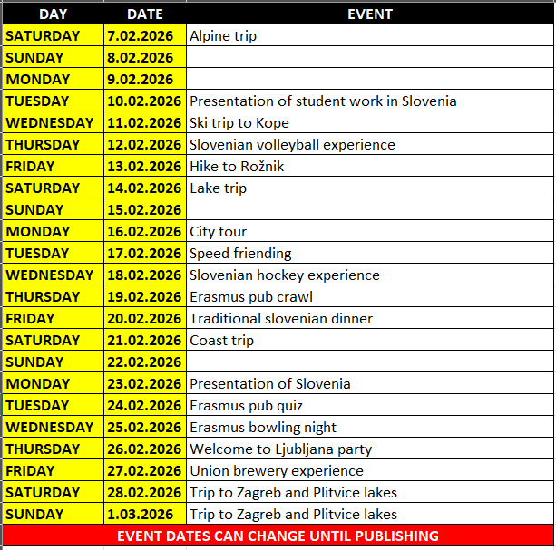
Welcome weeks & events
Tedni dobrodošlice & dogodki
Telegram CHANNEL (publishing of events and event updates)
Telegram CHANNEL (objava dogodkov in obvestil o dogodkih)
events almost every day/night from 10.02.2026 until 28.02.2026
dogodki skoraj vsak dan/večer od 10.02.2026 do 28.02.2026
some events have very limited spots
nekateri dogodki imajo zelo omejeno število mest
for more information: esnlj.events@gmail.com
za več informacij: esnlj.events@gmail.com

Slide 11


Slide 12
Event and trip payment
Plačilo dogodkov in izletov
Ljubljana Erasmus discount card
Ljubljana Erasmus kartica ugodnosti
  For discounts to be valid, you need to acquire your Ljubljana Erasmus discount card before the first event you will attend while using the discount, otherwise you will need to pay the difference to the full price at the spot.
  Da bi ugodnosti bile veljavne si morate zagotoviti svojo Ljubljana Erasmus kartico ugodnosti pred udeležbo na prvem dogodku pri katerem ste koristili ugodnosti, v nasprotnem primeru boste morali doplačati razliko do polne cene.
ESN Ljubljana office (during office hours)
pisarna ESN Ljubljana (v času uradnih ur)
  with cash
  z gotovino
  with payment card (for trips only)
  s plačilno kartico (izključno za izlete)
Online payment
  with payment card on fienta.com
  s plačilno kartico na fienta.com
bank transfer
  For bank details please always write to our events email address esnlj.events@gmail.com, as bank details for bank transfers are different between some events and trips.
  Za bančne podatke nam prosim vedno pošljite elektronsko sporočilo na naš elektronski naslov esnlj.events@gmail.com saj se podatki za bančno nakazilo medsebojno razlikujejo pri različnih dogodkih in izletih.

Slide 13
Public transport
Javni prevoz
public city bus transport (LPP)
javni mestni avtobusni prevoz (LPP)
  20,00 EUR / monthly ticket
  20,00 EUR / mesečna vozovnica
  LPP passenger center (Slovenska cesta 56, 1000 Ljubljana) – opening hours from Monday to Friday from 6:30 to 15:30, and on Wednesday from 6:30 to 17:00
  LPP potniški center (Slovenska cesta 56, 1000 Ljubljana) – delovni čas od ponedeljka do petka od 8:00 do 15:30 in ob sredah od 8:00 do 17:00
public bikes (BicikeLJ)
javna kolesa (BicikeLJ)
  3,00 EUR / yearly fee
  3,00 EUR / letna pristojbina
Urbana app (for bus schedule, single bus tickets, parking payment, … )
aplikacija Urbana (avtobusni vozni red, posamezne vozovnice za avtobus, plačilo parkirnine, … )
Get your own bike (bolha.com, bike repair shops)
kupi svoje lastno kolo (bolha.com, servisi in prodajalne koles)

Slide 14
Healthcare & residence permit
Zdravstvo & dovoljenje prebivanja
EMERGENCY NUMBER: 112
Številka za klic v sili: 112
Students healthcare center (Aškerčeva cesta 4, 1000 Ljubljana)
Študentski zdravstveni dom (Aškrčeva cesta 4, 1000 Ljubljana)
Residence permit information: https://www.uni-lj.si/en/study/international-students/temporary-residence-permit
informacije o dovoljenju za prebivanje: https://www.uni-lj.si/en/study/international-students/temporary-residence-permit
Special desk for exchange students (Tobačna ulica 5, 1000 Ljubljana)
From 16 – 27 February 2026 (Monday, Tuesday, Wednesday, from 10am to 2pm , Friday from 9am to 1 pm)
Document review table (UL Faculty of Arts, Tobačna ulica 5, above the restaurant Marjetica, 3rd floor)
Monday, Tuesday, Wednesday and Friday, 16 - 27 February, from 9am to 1pm.

Slide 15
Student work
Študentsko delo
Slovenian TAX number (Administrative unit – Davčna ulica 1, 1000 Ljubljana)
slovenska davčna številka (Administrative unit – Davčna ulica 1, 1000 Ljubljana)
bank account at one of the Slovenian banks
bančni račun na eni izmed slovenskih bank
referral from the student service
napotnico za delo s strani študentskega servisa
International student card (internship only students)
mednarodno študentsko izkaznico (študentje v Sloveniji izključno na študijski praksi)

Slide 16
ESN Ljubljana
our email address: esn@sou-lj.si
naš elektronski naslov: esn@sou-lj.si
ESN Ljubljana 2025/26 – Official Telegram CHANNEL: https://t.me/esnljubljana2025_26
ESN Ljubljana 2025/26 – Official Telegram CHAT GROUP: https://t.me/+bjpIGu4poUs5Yjg0
Events registration website: https://esn-sou-lj.si/
Spletna stran za prijavo na dogodke: https://esn-sou-lj.si/
Facebook (@esnljubljana): https://www.facebook.com/esnljubljana
Instagram (@esnljubljana): https://www.instagram.com/esnljubljana/
all important links at one place – LinkTree: https://linktr.ee/esnljubljana
vse pomembne spletne povezave na enem mestu – LinkTree: https://linktr.ee/esnljubljana
ESN Ljubljana office hours are available on LinkTree
Uradne ure ESN Ljubljana pisarne so na voljo na LinkTree

Slide 17
THANK YOU!

