Slide 1
How do you, students of the S.S. Cyril and Methodius University – Faculty of Law in Skopje, see other nations?
Qualitative content validation of quantitative results on stereotypes and social distance
Prof. Dr. Rok Zupančič
rok.zupancic@fdv.uni-lj.si
S.S Cyril and Methodius University, Faculty of Law
Skopje, 11 March 2026

Slide 2
Methods
Idea of research project on cultura/ethnic/social distance
46 participants from Macedonia (students aged 20—25)
Ethnic background (MK: 43, SR: 2, OTH: 1 (Vlachs))
16 male, 30 female
Survey conducted in-person with students of your faculty in April 2025

Slide 3
Heterostereotypes
11 positive and negative adjectives to describe former Yugoslav nations
7-point scale (1 – does not apply at all, 4 – partially applies, 7 – fully applies)

Slide 4
Heterostereotypes
11 positive and negative adjectives to describe “power” nations
7-point scale (1 – does not apply at all, 4 – partially applies, 7 – fully applies)

Slide 5
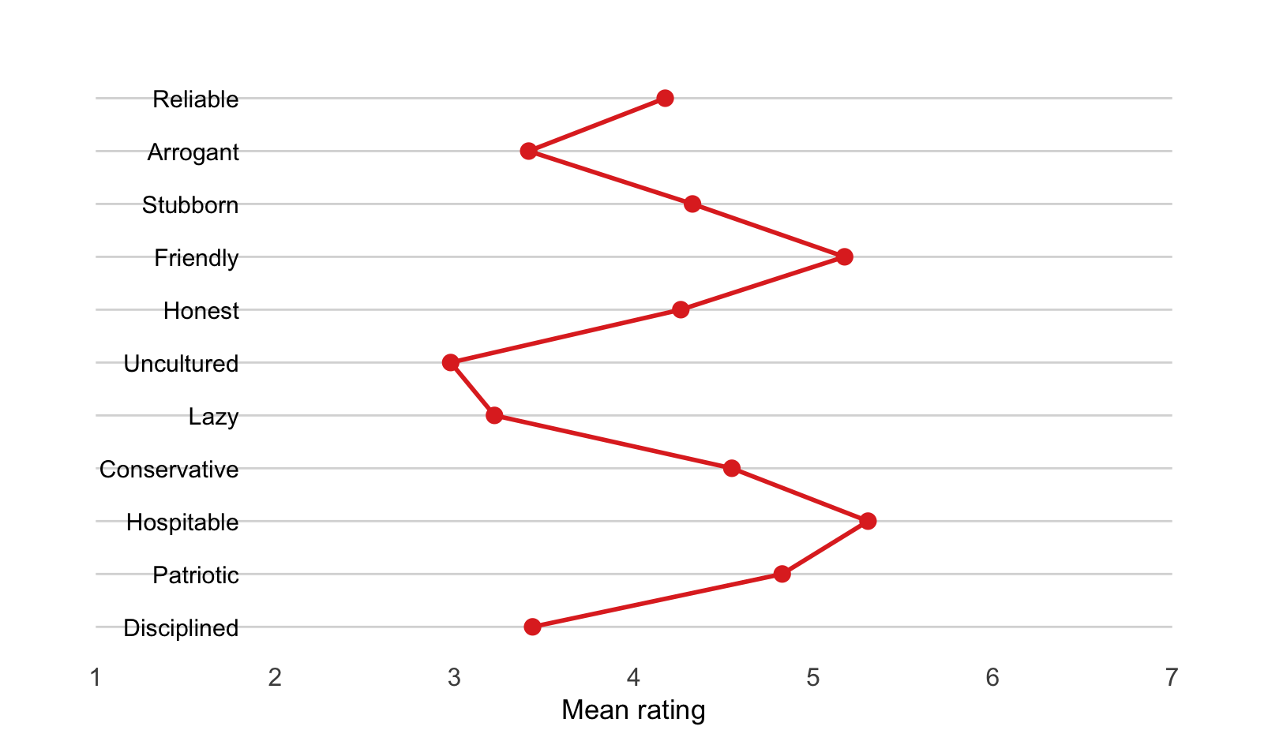
Autostereotypes
11 positive and negative adjectives to describe Macedonians
7-point scale (1 – does not apply at all,
4 – partially applies, 7 – fully applies)

Slide 6
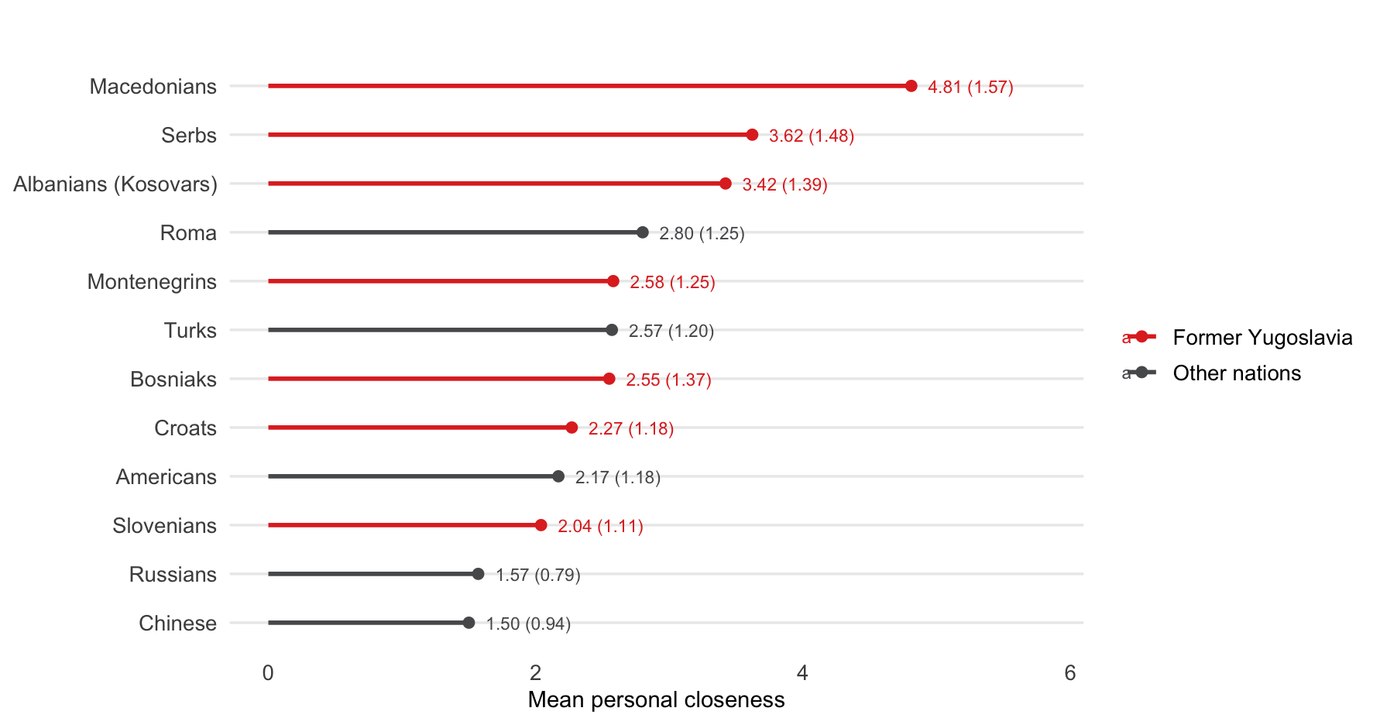
Perceived personal contact
How often do you have personal contact with people of the following nationalities?
5-point frequency scale (1 – never,
5 – very often)

Slide 7
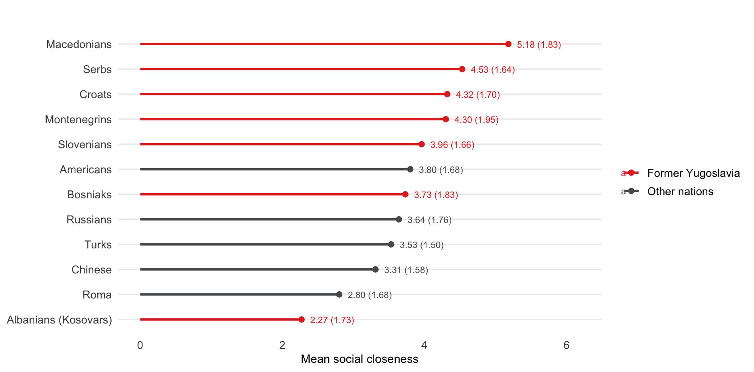
Perceived social closeness
Bogardus Social Distance Scale
willing to completely exclude members of the nation from
Northen Macedonia
live with them in the same country,
live with them in the same city,
have them as neighbors,
have them as friends,
marry a member of the nation,
have them as a family member.
Sum of binary responses (1—5)

Slide 8
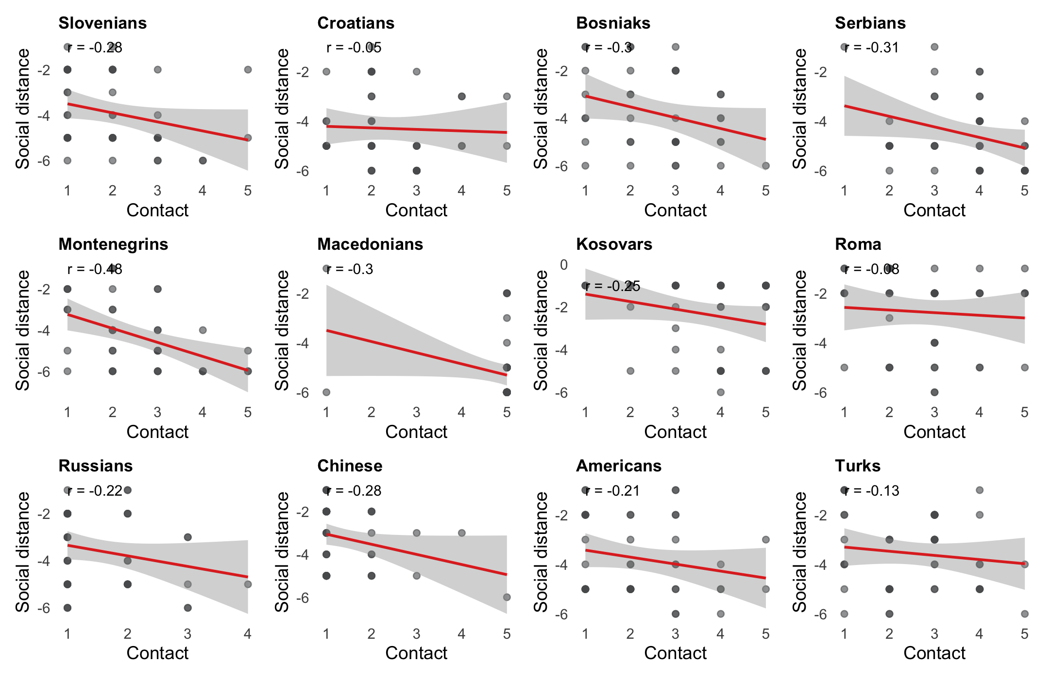
More personal contact is connected to less social distance
Slovenians: r = –.28, p = .06
Croatians: r = –.05, p = .07
Bosniaks: r = –.30, p = .07
Serbians: r = –.31, p = .05
Montenegrins: r = –.48, p < .001
Kosovars: r = –.25, p = .10
Roma: r = –.08, p = .62
Russians: r = –.22, p = .15
Chinese: r = –.28, p = .06
Amercians: r = –.21, p = .17
Turks: r = –.13, p = .39

Slide 9
Thank you!
rok.zupancic@fdv.uni-lj.si

