Slide 1
How do Croatians see other nations?
Qualitative content validation of quantitative results on stereotypes and social distance
Prof. Dr. Boštjan Udovič
Croatia

Slide 2
Methods
63 Croatian participants (aged 19—35)
21 male, 42 female
Survey conducted in academic year 2024/25

Slide 3
Heterostereotypes
11 positive and negative adjectives to describe former Yugoslav nations
7-point scale (1 – does not apply at all, 4 – partially applies, 7 – fully applies)

Slide 4
Heterostereotypes
11 positive and negative adjectives to describe “power” nations
7-point scale (1 – does not apply at all, 4 – partially applies, 7 – fully applies)

Slide 5
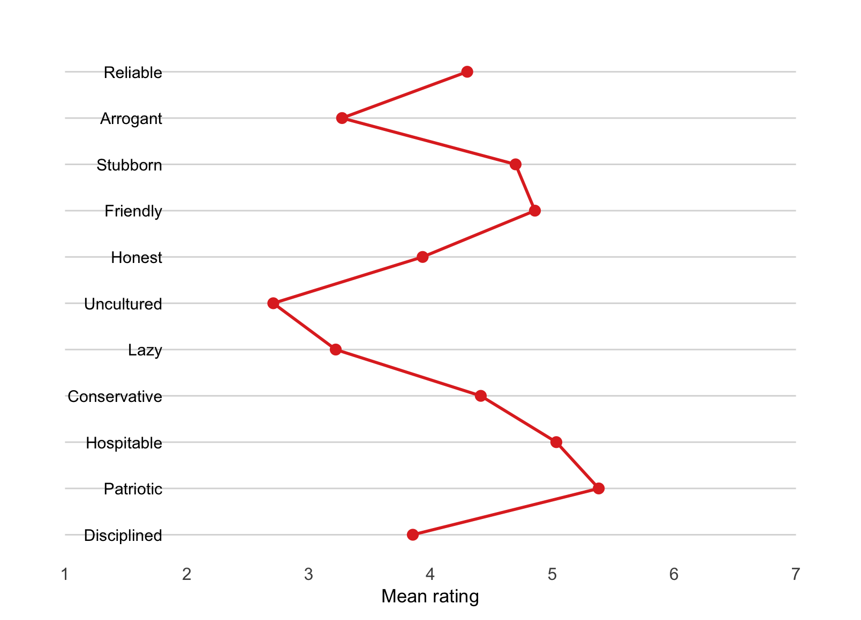
Autostereotypes
11 positive and negative adjectives to describe Croatians
7-point scale (1 – does not apply at all,
4 – partially applies, 7 – fully applies)

Slide 6
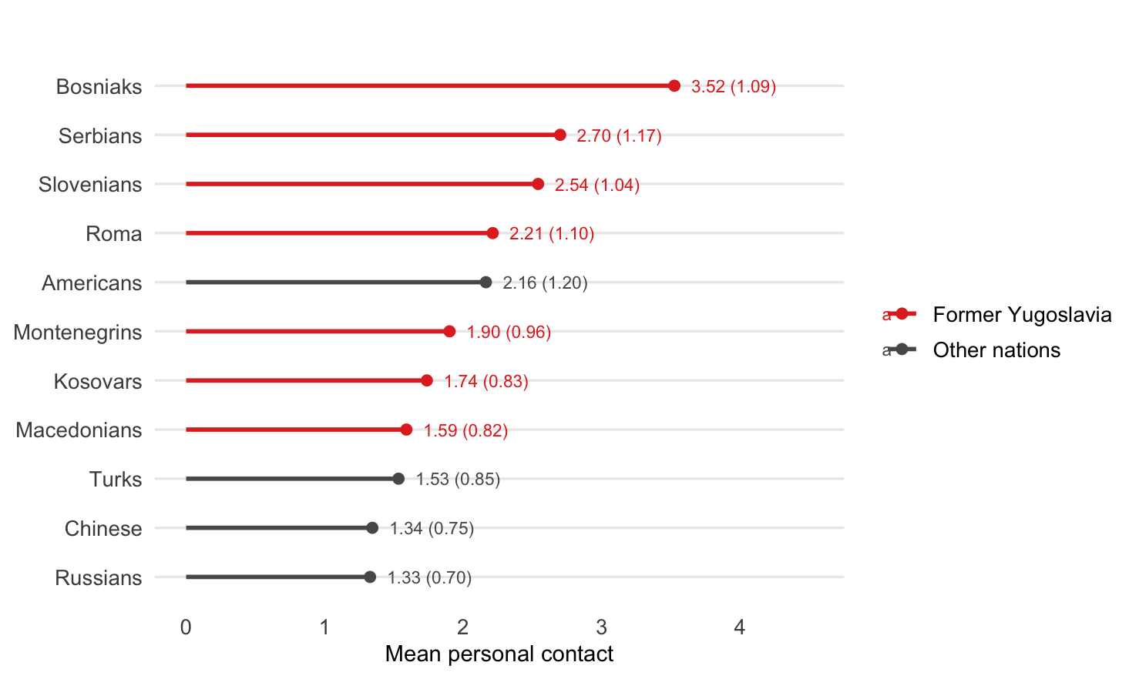
Perceived personal contact
How often do you have personal contact with people of the following nationalities?
5-point frequency scale (1 – never,
5 – very often)

Slide 7
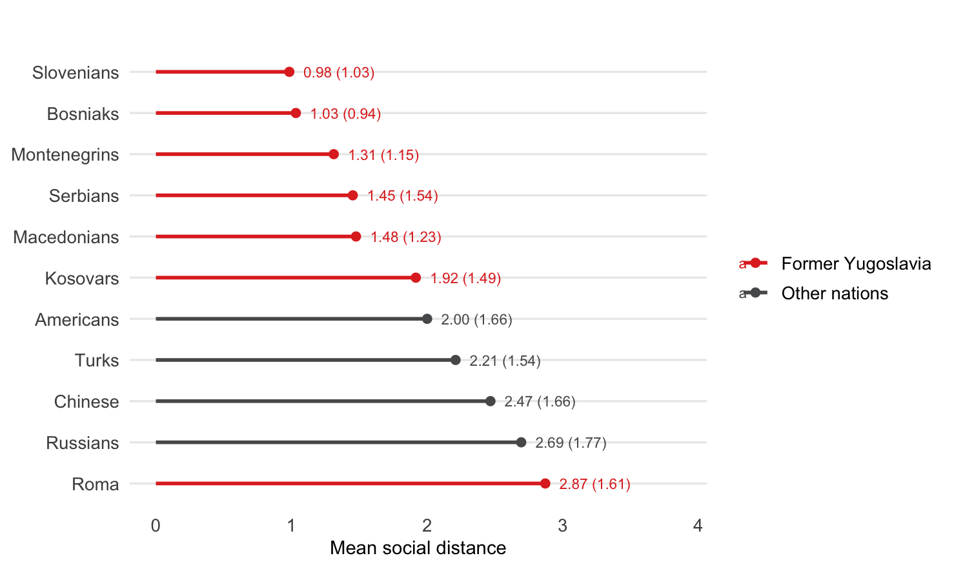
Perceived social distance
Bogardus Social Distance Scale
willing to completely exclude members of the nation from
Croatia
live with them in the same country,
live with them in the same city,
have them as neighbors,
have them as friends,
marry a member of the nation,
have them as a family member.
Reversed sum of binary responses
(1—7)

Slide 8
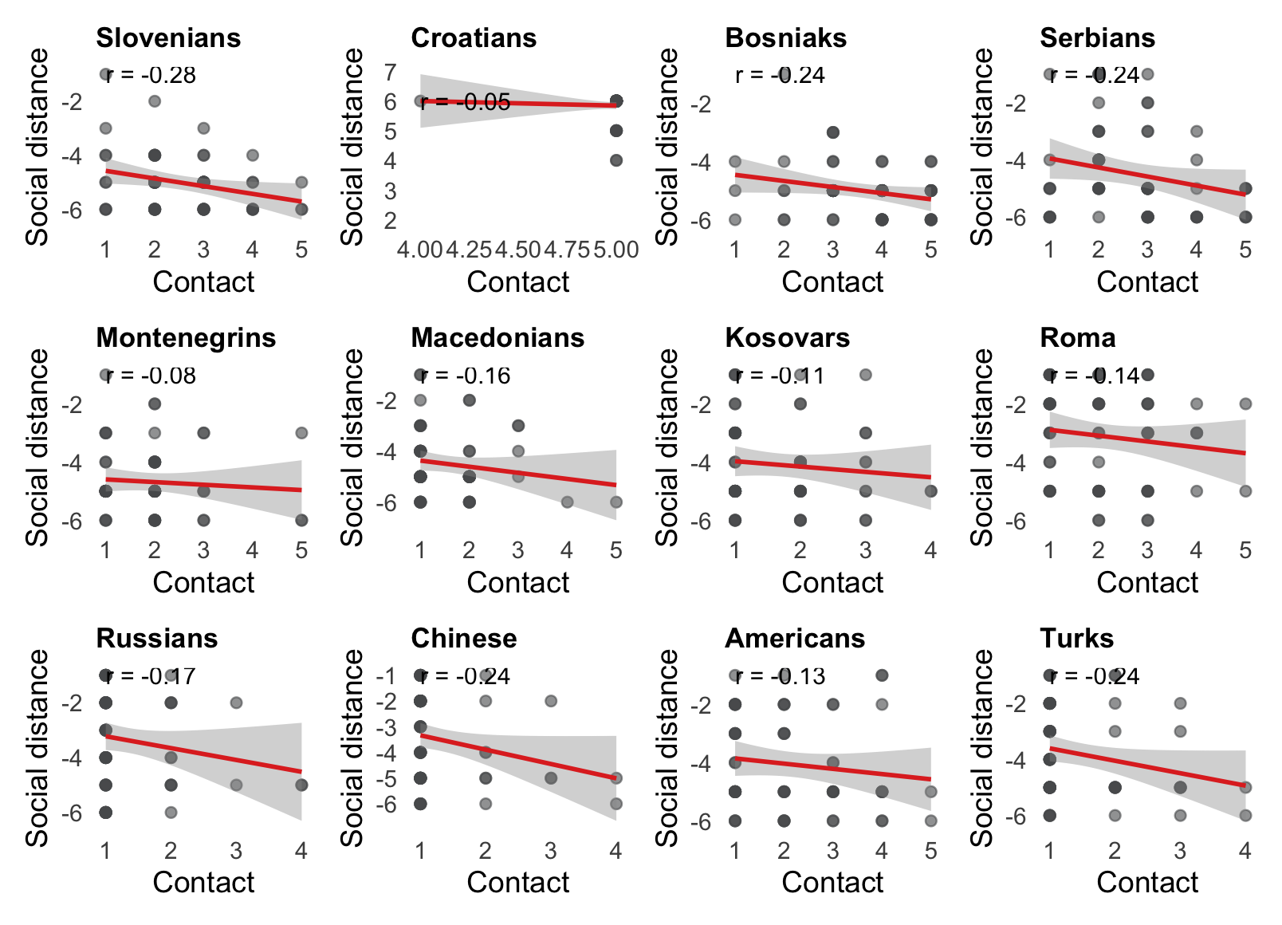
More personal contact is connected to less social distance
Slovenians: r = –.28, p = .028
Bosniaks: r = –.24, p = .065
Serbians: r = –.24, p = .069
Macedonians: r = –.16, p = .225
Kosovars: r = –.11, p = .428
Russians: r = –.17, p = .188
Americans: r = –.13, p = .317
Turks: r = –.24, p = .068
Chinese: r = –.24, p = .066

Slide 9
Thank you!

